Slide 1
Cold Frontal Zone
N
E
Reproduced from Synoptic-Dynamic Meteorology in Midlatitudes, Vol. II

Slide 2
Cold Front Structure
SE
NW
Contoured
Potential temperature (every 5 K)
Barbs
Horizontal wind (half-flag: 5 kt, full flag: 10 kt, pennant: 50 kt)
100 km
note well-mixed θ behind front
1 km
Reproduced from Synoptic-Dynamic Meteorology in Midlatitudes, Vol. II

Slide 3
Cold Frontal Inversion
Obtained from http://weather.uwyo.edu/upperair/sounding.html

Slide 4
Warm Frontal Zone
N
T-3ΔT
T-2ΔT
T-ΔT
T
E

Slide 5
Warm Front Structure
S
N
Contoured
Potential temperature (every 5 K)
Barbs
Horizontal wind (half-flag: 5 kt, full flag: 10 kt, pennant: 50 kt)
200 km
1 km
θ less well-mixed ahead of front
Reproduced from Synoptic-Dynamic Meteorology in Midlatitudes, Vol. II

Slide 6
Warm Frontal Inversion
Obtained from http://weather.uwyo.edu/upperair/sounding.html

Slide 7
Cold vs. Warm Front Motion
L
T-2ΔT
T-ΔT
T

Slide 8
Cold vs. Warm Front Motion
Implication: frontogenetic situation
Initial Force Balance: geostrophic
Warm where warm, cool where cold
Changes thickness, near-surface pressure, and thus the horizontal pressure gradient force
Result: ageostrophic flow from cold to warm
(geostrophic adjustment)
This accelerates cold front motion and decelerates warm front motion!
Reproduced from Mesoscale Meteorology in Midlatitudes, Fig. 5.6.

Slide 9
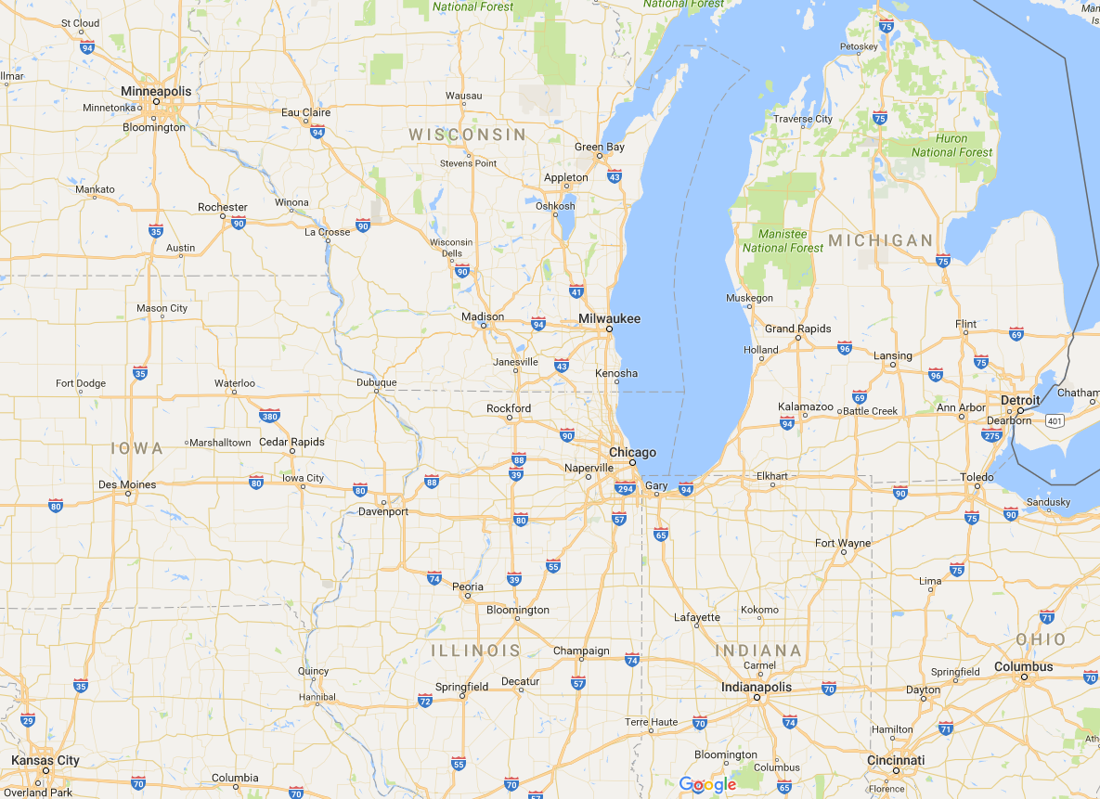
Cold vs. Warm Front Motion
L
strong sensible cooling = mesoscale anticyclogenesis
acts to hinder poleward warm front propagation near Lake Michigan
Base map from Google Maps

Slide 10
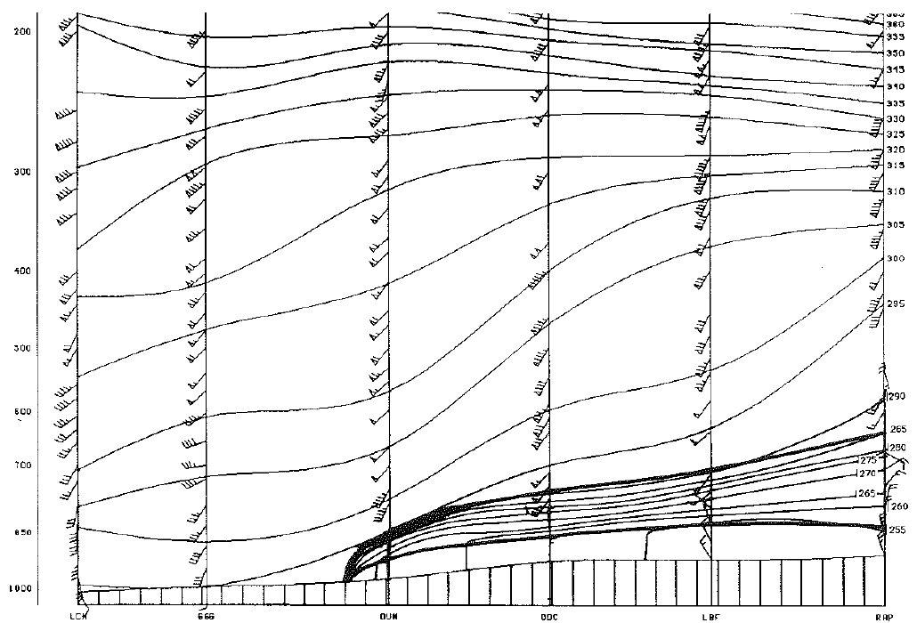
Cold vs. Warm Front Slope: Surface Drag
cold front: drag slows advancing cold air
warm front: drag slows advancing warm air
Reproduced from Synoptic-Dynamic Meteorology in Midlatitudes, Vol. II

Slide 11
Cold vs. Warm Front Slope: Sensible Heating
cooler
warmer
warmer
cooler
cold front: sensible heat flux to air
promotes deeper vertical mixing
warm front: sensible heat flux to soil,
cloud cover limits insolation; shallower vertical mixing
Reproduced from Synoptic-Dynamic Meteorology in Midlatitudes, Vol. II

Slide 12
Cyclone Structure
Reproduced from Browning (2005, Quart. J. Roy. Meteor. Soc.)

Slide 13
Cyclone Structure and Satellite Imagery
Obtained from UW-Madison CIMSS via Twitter

Slide 14
Isoplething and Frontal Analysis
Solid Contours
Sea-level pressure (every 4 hPa, leading 1 omitted)
Dashed Contours
Temperature (every 10°C)
Reproduced from Synoptic-Dynamic Meteorology in Midlatitudes, Vol. II

Slide 15
Isoplething and Frontal Analysis
Red Contours
Temperature (every 5°F)
Blue Contours
Sea-level pressure (every 4 hPa)
Green Shading
Areas of precipitation
Base map and data from UCAR/NCAR/RAL

Slide 16
Isoplething and Frontal Analysis
Green Contours
Dew point temperature (every 5°F)
Cold front in black line
Base map and data from UCAR/NCAR/RAL

Slide 17
Isoplething and Frontal Analysis
Base map and data from Plymouth State University

Slide 18
Frontogenesis: Horizontal Shear
Reproduced from Mesoscale Meteorology in Midlatitudes, Fig. 5.4a.

Slide 19
Frontogenesis: Diffluence
Reproduced from Mesoscale Meteorology in Midlatitudes, Fig. 5.4b.

Slide 20
Frontogenesis: Tilting
Reproduced from Mesoscale Meteorology in Midlatitudes, Fig. 5.4c.

Slide 21
Frontogenesis: Diabatic Heating
Reproduced from Mesoscale Meteorology in Midlatitudes, Fig. 5.4d.

Slide 22
Frontogenesis: Total Deformation
Reproduced from Mesoscale Meteorology in Midlatitudes, Fig. 5.5.

