Slide 1
Internal Gravity Waves
z
z
ρ₁
θ_{p} < θ_{env}
ρ₂
θ_{p} > θ_{env}
θ
ρ₁ < ρ₂
Ascending (descending) air parcels will oscillate about their initial location due to buoyancy given this stratification.

Slide 2
Internal Gravity Waves
Phase lines (with prescribed slope)
Individual waves (with phase speed perpendicular to the phase lines and parcel oscillations along the phase lines)
Pressure perturbations determined from their relationship to u’ and w’
Temperature perturbations determined from their relationship to u’ and w’; work from bottom right to top left along a wave to interpret physically.
(W = warm, C = cold)
Given c_{g} and the phase lines, gravity waves propagate up/away from their source at the origin.
z
φ₀
φ₁
φ₂
c_{g}
H
φ₃
W
λ_{x}
L
C
H
λ_{z}
φ₄
W
L
C
H
c_{p}
See Figs. 6.4-6.6 in Markowski and Richardson (2010) for slightly different depictions of these concepts.
x

Slide 3
Ducted Gravity Waves
z
ρ₁
less stable
c_{g}
ρ₂
more stable
ρ₁ < ρ₂

Slide 4
Ducted Gravity Wave Structure
Assumes no base-state horizontal wind.
Markowski and Richardson (2010), their Fig. 6.10

Slide 5
Ducted Gravity Waves
Note that the critical level is above the stable layer and the wave’s phase speed exceeds the base-state mean wind throughout the stable layer.
less stable
more stable
Markowski and Richardson (2010), their Fig. 6.8

Slide 6
Ducted Gravity Waves
less stable
more stable
Markowski and Richardson (2010), their Fig. 6.9

Slide 7
Ducted Gravity Wave Environments
Markowski and Richardson (2010), their Fig. 6.11

Slide 8
Mesoscale Gravity Wave Case Study
Markowski and Richardson (2010), their Fig. 6.2

Slide 9
Mesoscale Gravity Wave Case Study
This is a long wavelength mesoscale gravity wave associated with a thunderstorm event in March 2008. There is at most one full wavelength of this gravity wave.
Ruppert and Bosart (2014, Mon. Wea. Rev.), their Fig. 6

Slide 10
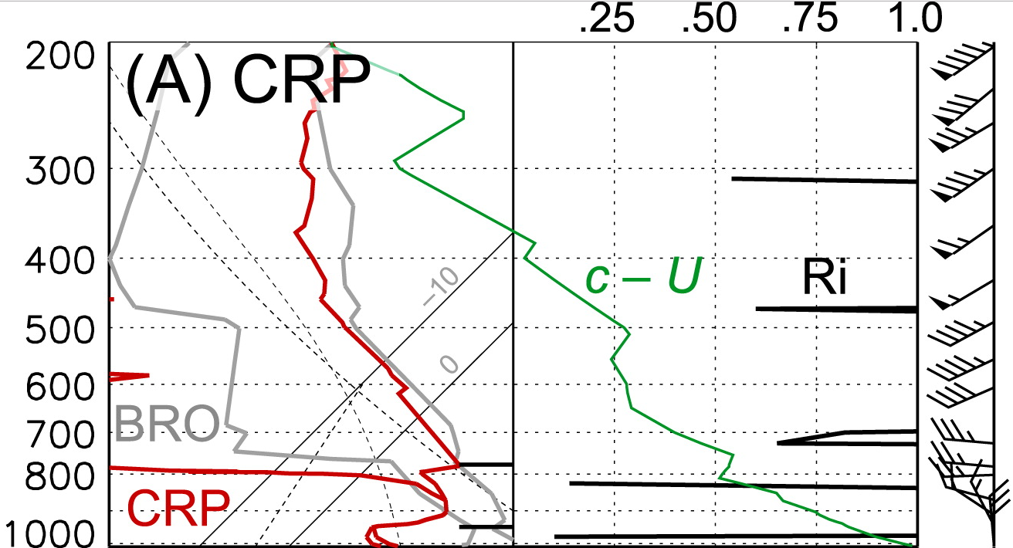
Mesoscale Gravity Wave Case Study
Note pressure fall and gusty winds with gravity wave passage.
Note presence of ~150 hPa thick stable layer beneath less stable layer, all with phase speed exceeding mean wind.
Ruppert and Bosart (2014, Mon. Wea. Rev.), their Figs. 5a and 7a

Slide 11
Ducted Gravity Wave Example
Markowski and Richardson (2010), their Fig. 6.3 (upper right)

Slide 12
Convection-Induced Gravity Waves
Obtained from satelliteliaisonblog.com, 21 March 2017

Slide 13
Density Current-Induced Bore
The advancing density current (dark blue) perturbs the existing stable layer (light blue), usually associated with a nocturnal inversion. This triggers wave oscillations there and further downstream.
Markowski and Richardson (2010), their Fig. 6.12

