Slide 1
Mesoscale Convective Features
Markowski and Richardson (2010), their Fig. 9.4

Slide 2
Mesoscale Convective Systems
Markowski and Richardson (2010), their Fig. 9.1

Slide 3
Bow Echoes and Line Echo Wave Patterns
Markowski and Richardson (2010), their Fig. 9.5

Slide 4
Mesoscale Convective Complexes
Markowski and Richardson (2010), their Fig. 9.6

Slide 5
Upscale Growth Relative to Vertical Shear
Upscale growth is less likely when the vertical wind shear is ~45° to the boundary along which convection initiated. Larger angles often support splitting supercells that interact with each other.
Upscale growth is favored when the vertical wind shear is parallel to the boundary along which convection initiated.
Markowski and Richardson (2010), their Fig. 9.2

Slide 6
Conceptual Model
Markowski and Richardson (2010), their Fig. 9.7

Slide 7
Numerical Model Representation
Markowski and Richardson (2010), their Fig. 9.3a-d

Slide 8
Surface Mass + Kinematic Fields
Markowski and Richardson (2010), their Fig. 9.10

Slide 9
Vertical Wind Profile (Trailing Stratiform MCS)
For a parallel stratiform MCS, the system-relative winds aloft will be line-parallel, such that stratiform precipitation is found downwind along the line.
Example: Veering or backing with height at upper levels
For a leading stratiform MCS, the system-relative winds aloft will be in the direction of MCS motion, such that stratiform precipitation is found ahead of the line.
Example: Faster winds with height at upper levels
Markowski and Richardson (2010), their Fig. 9.8

Slide 10
Classical MCS Archetypes
Trailing Stratiform
Leading Stratiform
Parallel Stratiform
Markowski and Richardson (2010), their Fig. 9.11

Slide 11
Leading and Parallel Stratiform MCSs
Markowski and Richardson (2010), their Fig. 9.12

Slide 12
TL-AS and Backbuilding MCSs
Schumacher and Johnson (2005, Mon. Wea. Rev.), their Fig. 3

Slide 13
Slab-Like vs. Cellular Convection
Markowski and Richardson (2010), their Fig. 9.13

Slide 14
Basics of RKW Theory
No Ambient Flow
Updraft tilts over the density current.
Westerly Ambient Shear
Updraft upright along leading edge as shear balances cold pool.
Markowski and Richardson (2010), their Fig. 9.14

Slide 15
Updraft Tilt and Vertical Wind Shear
When the ambient vertical wind shear better balances the cold pool, updrafts along the gust front have less tilt. This reduces the dilution of buoyancy along the updraft due to entrainment.
Markowski and Richardson (2010), their Fig. 9.15

Slide 16
Updraft Tilt and Vertical Accelerations
Smaller downward-directed vertical perturbation pressure gradient force; upward acceleration due to buoyancy less diminished.
Larger downward-directed vertical perturbation pressure gradient force (more mass given wider area that must be displaced).
Markowski and Richardson (2010), their Fig. 9.16

Slide 17
RKW Theory Control Volume
Markowski and Richardson (2010), their Fig. 9.17

Slide 18
RKW Theory States
Cold pool dominant
(later stages)
Optimal state
(initial stages)
Environmental shear dominant
(usually pre-cold pool only)
Markowski and Richardson (2010), their Fig. 9.18

Slide 19
Updraft Tilt and Upper Level Shear
No upper-level shear, upshear-tilted
No upper-level shear, optimal state
Westerly upper-level shear
Easterly upper-level shear
Markowski and Richardson (2010), their Fig. 9.21

Slide 20
Rear Inflow Development: Buoyancy
Markowski and Richardson (2010), their Fig. 9.22

Slide 21
Rear Inflow Development: Horizontal Vorticity
Markowski and Richardson (2010), their Fig. 9.23

Slide 22
Bow Echo Conceptual Model
RIJ
Markowski and Richardson (2010), their Fig. 9.24

Slide 23
Bow Echo Radar Depiction
Markowski and Richardson (2010), their Fig. 9.25

Slide 24
Line-End Vortex Formation
ω_{H} ≈ η < 0
Markowski and Richardson (2010), their Fig. 9.27

Slide 25
Mesoscale Convective Vortices
Markowski and Richardson (2010), their Fig. 9.29a

Slide 26
Mesoscale Convective Vortices
Markowski and Richardson (2010), their Fig. 9.30b

Slide 27
MCS with MCV
Markowski and Richardson (2010), their Fig. 9.31b

Slide 28
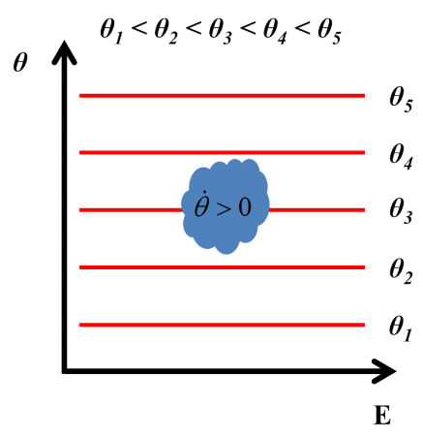
Stratiform Heating and Potential Vorticity
θ
Increased static stability, increased vertical vorticity, increased IPV
Decreased static stability, decreased IPV
Q
Left: Houze (1997, J. Atmos. Sci.), their Fig. 3

Slide 29
MCV Potential Vorticity Structure
Markowski and Richardson (2010), their Fig. 9.34

Slide 30
MCVs and Convective Redevelopment
mean wind
MCV-relative wind
Westerly shear implies a N-S temperature gradient from thermal wind. Rotational flow with the MCV fosters ascent east and descent west.
Air parcels along MCV-relative streamlines that conserve θ will ascend east and descend west of the MCV.
Markowski and Richardson (2010), their Fig. 9.34

