Slide 1
Simplified Sea Breeze Schematic
return flow
p
p_{top}
warm
cold
p_{bot}
sea breeze
E
Note: land breeze is similar, except with the circulation directed in the opposite direction.

Slide 2
Sea Breeze
Dashes = HCRs
Shading: 0, 4, 8 dBZ
Figure from Mesoscale Meteorology in Mid-Latitudes, their Fig. 5.33.

Slide 3
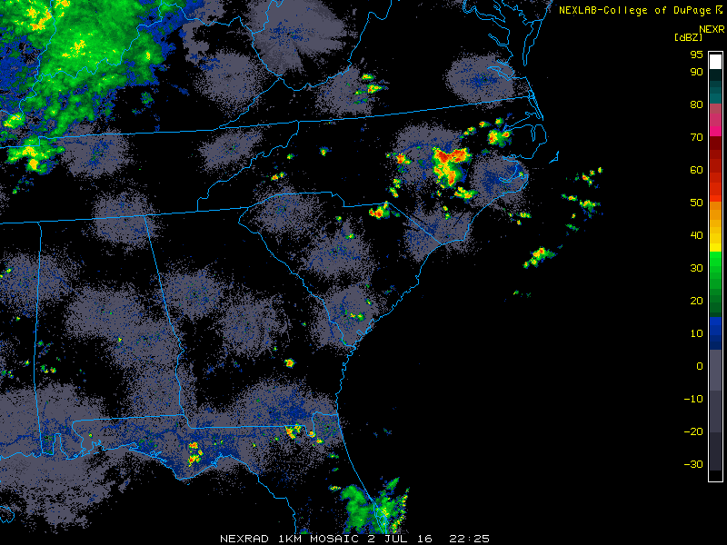
Sea Breeze Identification on Radar
Figure from College of DuPage, as archived on the UCAR/MMM Image Archive page.

Slide 4
Sea Breeze Vertical Structure
Figure from Simpson (1994; Cambridge Press), their Fig. 3.1.

Slide 5
Sea Breeze Vertical Structure
Plotted: r_{v} (g kg⁻¹)
Figure from Simpson (1994; Cambridge Press), their Fig. 3.3.

Slide 6
Warm-Season Lightning in Florida
Daily
Nocturnal Only
Flash Density (flashes km⁻² yr⁻¹)
Figure from Lericos et al. (2002, Wea. Forecasting), their Fig. 2.

Slide 7
Warm-Season Lightning in Florida
Calm Winds
Northwest Flow
Easterly Flow
Westerly Flow
Ridge Over N. Florida
Ridge Over S. Florida
Flash Density (x10⁻¹ flashes km⁻² day⁻¹)
Figure from Lericos et al. (2002, Wea. Forecasting), their Fig. 8.

Slide 8
Warm-Season Lightning along Gulf Coast
Daily
Nocturnal Only
Flash Density (flashes km⁻² yr⁻¹)
Top (Bottom) Numbers: a (b)
Figure from Smith et al. (2005, Wea. Forecasting), their Fig. 2.

Slide 9
Area Projection Schematic
Figure from Mesoscale Meteorology in Mid-Latitudes, their Fig. 2.3.

Slide 10
Bjerknes’ Circulation Theorem
Density is lower over land where it is warm and higher over water where it is cold.
Pressure varies with thickness.
Line segments AD and BC, as well as AB and CD, are not of equal length; i.e., circulation is not a perfect square.
Figure from Mid-Latitude Atmospheric Dynamics, their Fig. 5.3.

Slide 11
Bjerknes’ Circulation Theorem
water
land
Figure from Mesoscale Meteorology in Mid-Latitudes, their Fig. 2.4.

