Slide 1
Skew T-ln p Diagrams
Negatively-sloped orange lines: dry adiabats
Positively-sloped orange lines: skewed isotherms (°C)
Curved green lines: pseudoadiabats
Dashed blue lines: constant mixing ratio lines (g kg⁻¹)
Horizontal black lines: isobars (hPa; logarithmic axis)
From Grant Petty’s A First Course in Atmospheric Thermodynamics supplementary material

Slide 2
Computing Routine Thermodynamic Variables
θ: follow a dry adiabat downward from the T profile to 1000 hPa
LCL: follow a dry adiabat upward from the T at a given level; follow a constant mixing ratio line upward from the T_{d} at a given level
θ_{e}: find the LCL, then follow a pseudoadiabat upward until parallel with the dry adiabats, then follow a dry adiabat down to 1000 hPa
T_{w}: find the LCL, then follow a pseudoadiabat downward to the original parcel level
Fig. 2.2 from Markowski and Richardson

Slide 3
Computing Routine Thermodynamic Variables
LFC: level at which the parcel becomes positively-buoyant (note differences depending on whether T or T_{v} is used)
EL: level at which the parcel ceases to be positively-buoyant
CAPE: area between parcel and environment T or T_{v} curves between the LFC and EL
CIN: area between parcel and environment T or T_{v} curves below the LFC
Fig. 2.9 from Markowski and Richardson

Slide 4
Computing Routine Thermodynamic Variables
Thick brown dashed line: ascending parcel trace for a surface-based parcel (based on T_{v})
Thin brown dashed line: ascending parcel trace for a surface-based parcel (based on T)
Thick red dashed line: environmental T_{v}
Thin light blue line: environmental T_{w}
-20° to -30°C: favored hail growth zone
-12°C to -18°C: favored dendrite growth zone
Image courtesy NOAA/NWS Storm Prediction Center

Slide 5
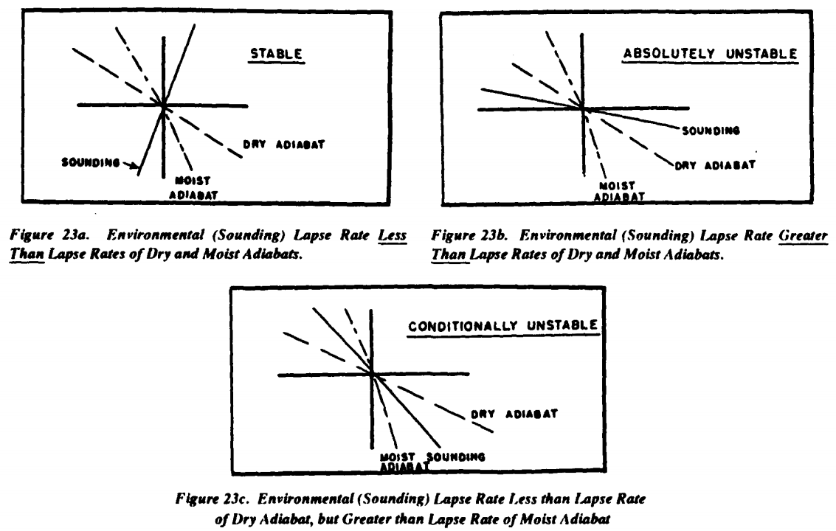
Parcel Method and Stability
Image from Fig. 23 of “The Use of the Skew T, Log P Diagram in Analysis and Forecasting”

Slide 6
Layer Method and Stability
Here, the lower portion of the layer is closer to saturation than is the top (which does not reach saturation even after 60 hPa ascent).
Note the moisture profile modification: along a mixing ratio line to saturation, then along a pseudoadiabat (but not to supersaturation).
Result: destabilized layer that is absolutely unstable in its lowest 25-30 hPa.
Consistent with θ_{e} decrease with height: destabilizing/potentially unstable.
Fig. 3.3 from Markowski and Richardson

Slide 7
Layer Method and Stability
Here, we’ve assumed an unsaturated layer that does not reach saturation upon ascent.
Result: destabilized layer that remains absolutely stable throughout.

Slide 8
Hodographs
This vector defines the thermal wind vector over this layer.
Note: artistic liberty was taken to curve this example hodograph.
km AGL
v
Fig. 2.11 from Markowski and Richardson

Slide 9
Hodographs
c: estimated feature motion
v - c: feature-relative wind vector at some generic altitude; usually the layer-mean wind
ω_{H}: 90° to the left of the shear vector S
ω_{S}: the component of ω_{H} that is along the feature-relative wind vector
ω_{C}: the component of ω_{H} that is across the feature-relative wind vector
Fig. 2.12 from Markowski and Richardson

Slide 10
Crosswise Vorticity Example
v
Red vector: hodograph from 0-3 km
This example depicts a veering wind profile with wind speed variation.
Yellow star: layer-mean wind
The feature-relative wind in this example is along the hodograph: easterly near the surface, westerly near 3 km.
Blue arrow: horizontal vorticity vector, 90° to the left of the local shear vector (parallel to the hodograph)
Feature-relative wind along hodograph = all horizontal vorticity is crosswise.
u

Slide 11
Streamwise Vorticity Example
v
Red curve: hodograph from 0-3 km
This example depicts a strongly veering wind profile but no wind speed variation.
Yellow star: layer-mean wind
The feature-relative wind (green arrow) is identical to the ground-relative wind.
Blue arrow: horizontal vorticity vector, 90° to the left of the local shear vector (parallel to the hodograph)
Feature-relative wind along horizontal vorticity vector = all streamwise vorticity.
u

Slide 12
Observed Hodograph Example
Focus on the hodograph between 0-2 km.
Yellow star: 0-2 km layer-mean wind
The feature-relative wind (green arrow) at 1 km is predominantly southerly.
Blue arrow: horizontal vorticity vector, 90° to the left of the local shear vector
Feature-relative wind almost entirely along horizontal vorticity vector = predominantly streamwise vorticity.
Image courtesy NOAA/NWS Storm Prediction Center

Slide 13
Importance of Streamwise Vorticity
Red vector: local vertical shear vector.
Blue vector: horizontal vorticity vector.
In this example, horizontal vorticity defines clockwise rotation in the x-z plane.
Grey cloud: an updraft along the flow
This tilts the vortex line parallel to the horizontal vorticity vector into the vertical.
Result: counter-rotating vortices (H and L).
H
L

Slide 14
Importance of Streamwise Vorticity
H
Purple vector: feature-relative wind vector.
In this example, the feature-relative wind advects the counter-rotating vortices parallel to the vertical shear vector.
L

Slide 15
Importance of Streamwise Vorticity
H
Purple vector: feature-relative wind vector.
In this example, the feature-relative wind advects the cyclonic vortex toward the updraft.
This can allow for the amplification of cyclonic rotation by vortex tube stretching.
L

