Slide 1
Tropical Cyclone Intensity Change

Slide 2
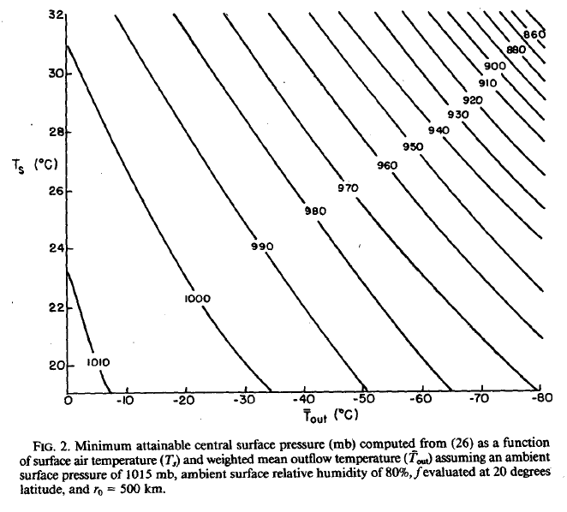
Potential Intensity: pmin
(Figure obtained from Emanuel (1986), © 1986 American Meteorological Society.)

Slide 3
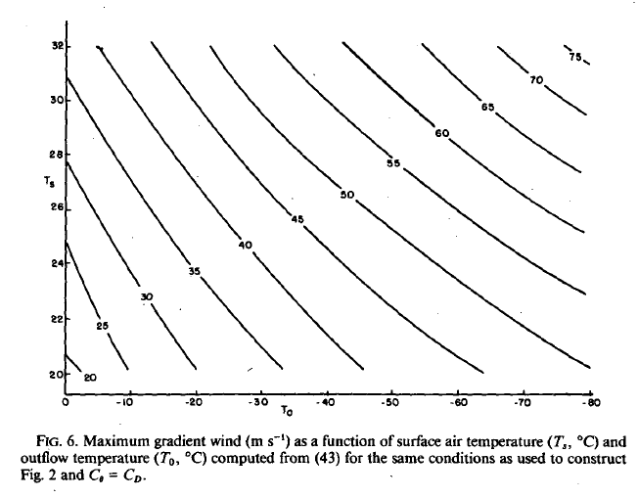
Potential Intensity: vmax
(Figure obtained from Emanuel (1986), © 1986 American Meteorological Society.)

Slide 4
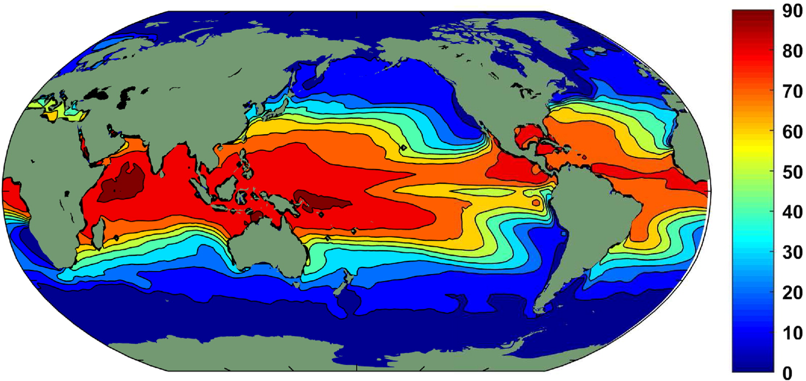
Potential-Intensity Climatology
(Figure obtained from Emanuel (2019), © 2019, American Meteorological Society.)

Slide 5
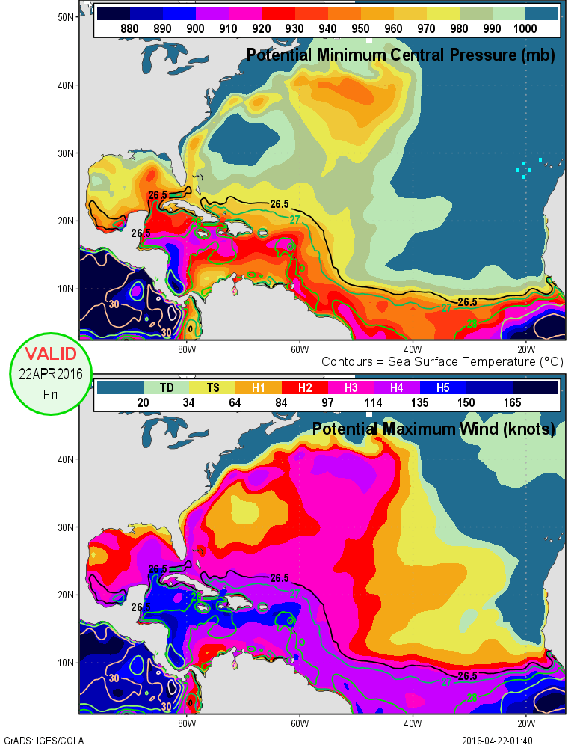
Potential Intensity Example
(Figure obtained from http://www.wxmaps.org/.)

Slide 6
Upwelling by Tropical Cyclones
(Figure obtained from Hart et al. (2007). © 2007, American Meteorological Society.)

Slide 7
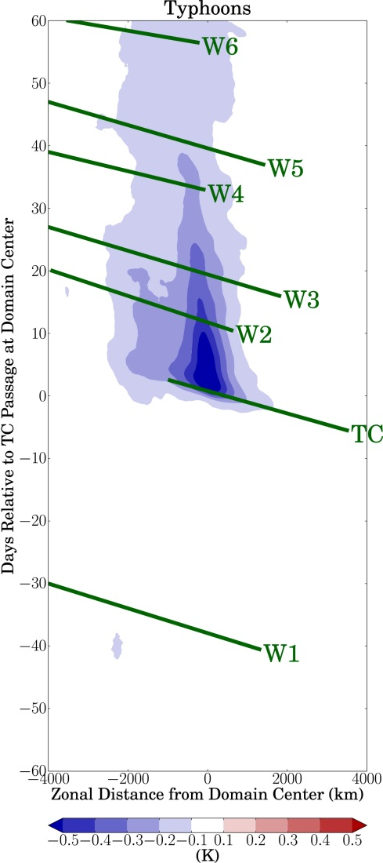
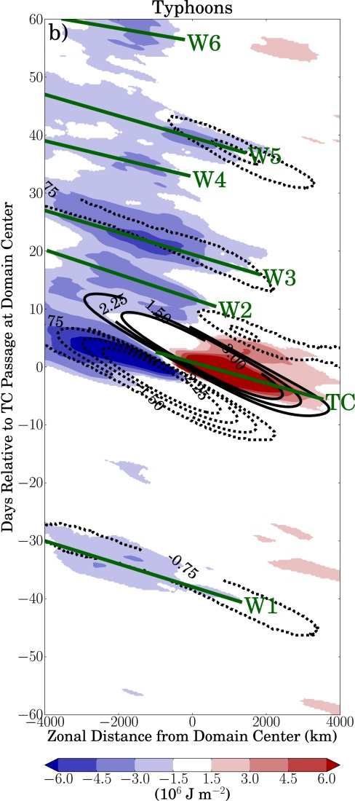
Tropical Cyclone Upwelling and Cooling
SST cooling
time after TC passage
Reduced moist static energy (cooling and especially drying)
(Figure obtained from Schenkel and Hart (2015). © 2015, American Meteorological Society.)
Notes:
The low MSE anomalies are in part forced by the lower SSTs (and thus reduced sensible and latent heat fluxes from ocean to air), but also by meridional advection of low MSE air from poleward regions as forced by, purportedly, TC-induced Rossby waves over a long period of time.

Slide 8
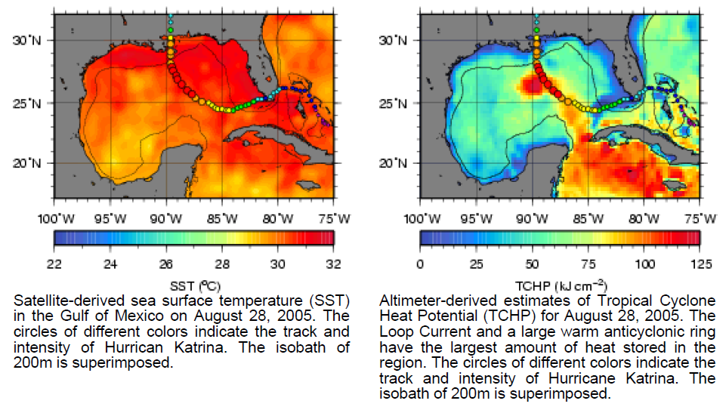
Oceanic Eddies: Hurricane Katrina (2005)
(Figure obtained from http://www.aoml.noaa.gov/phod/cyclone/data/.)

Slide 9
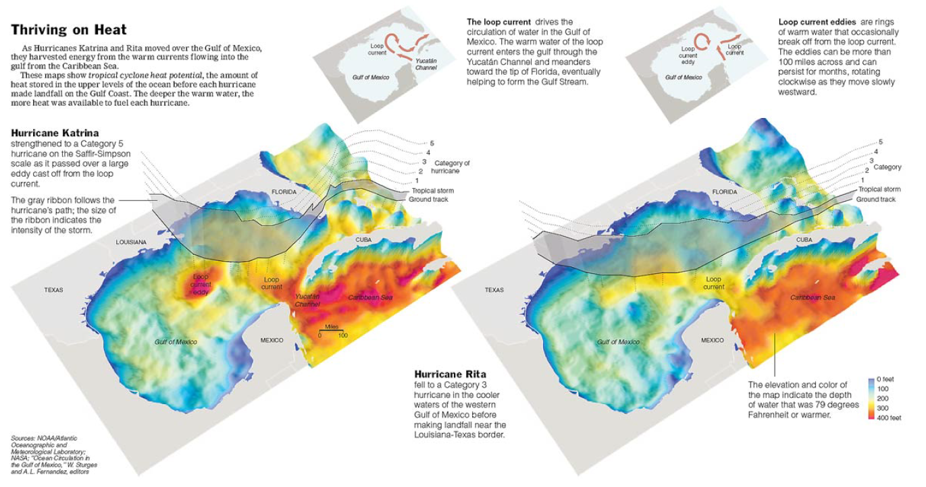
Oceanic Eddies: Katrina and Rita (2005)
(Figure obtained from http://www.aoml.noaa.gov/phod/cyclone/data/ by way of the New York Times.)

Slide 10
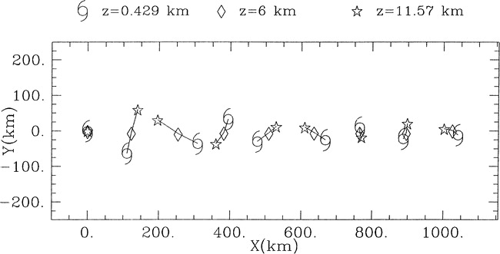
Mutual Vortex Rotation in Shear
(Figure obtained from Jones (2004). © 2004, American Meteorological Society.)

Slide 11
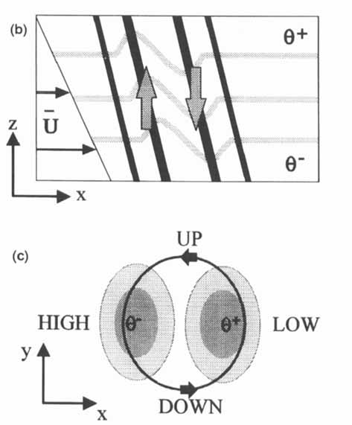
Vertical Circulation Development
Vertical advection of potential temperature
Isentropic ascent through potential temperature anomalies
(Figure obtained from Jones (1995). © 1995, Wiley Interscience.)

Slide 12
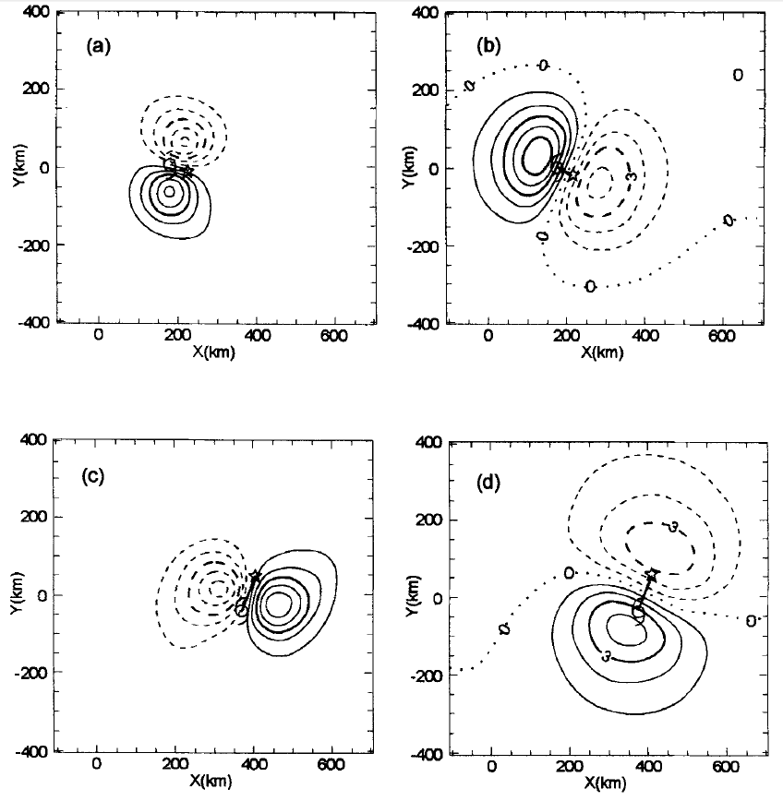
Vertical Circulation Development
t = 24 h
w at z = 5 km
Θ’ at z = 5 km
t = 48 h
(Figure obtained from Jones (1995). © 1995, Wiley Interscience.)

Slide 13
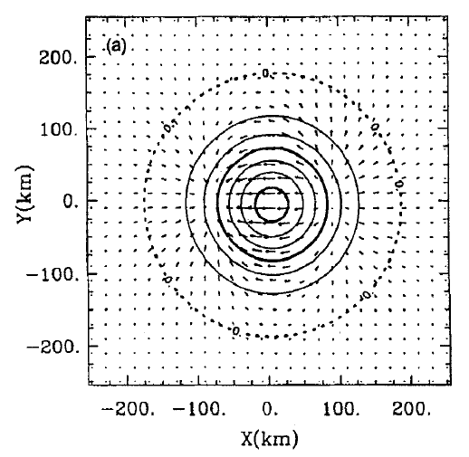
Inner Core Vortex Tilt Reduction
PV (contoured)
Divergent flow (vectors)
Chart is near tropopause in westerly shear
(Figure obtained from Jones (1995). © 1995, Wiley Interscience.)

Slide 14
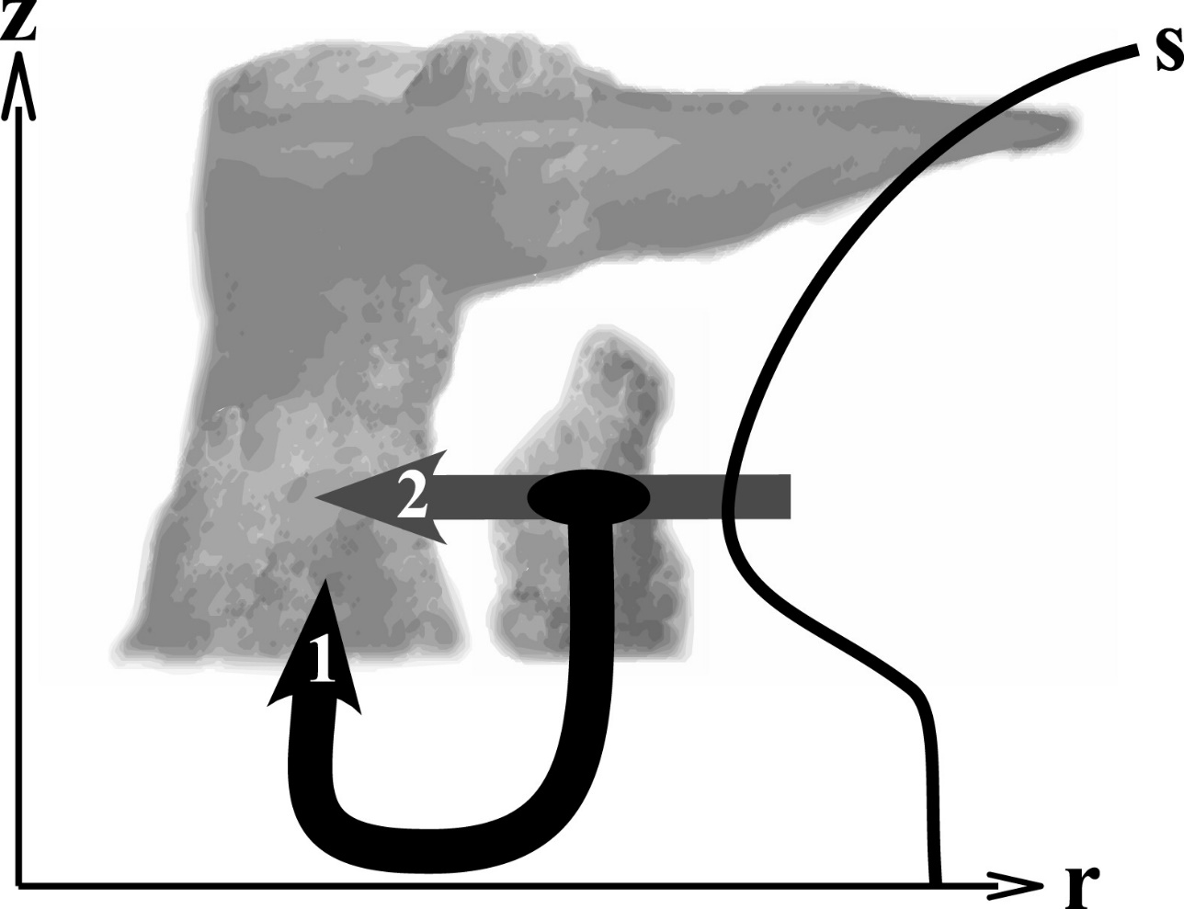
Ventilation Pathways
(Figure obtained from Tang and Emanuel (2010). © 2010, American Meteorological Society.)

Slide 15
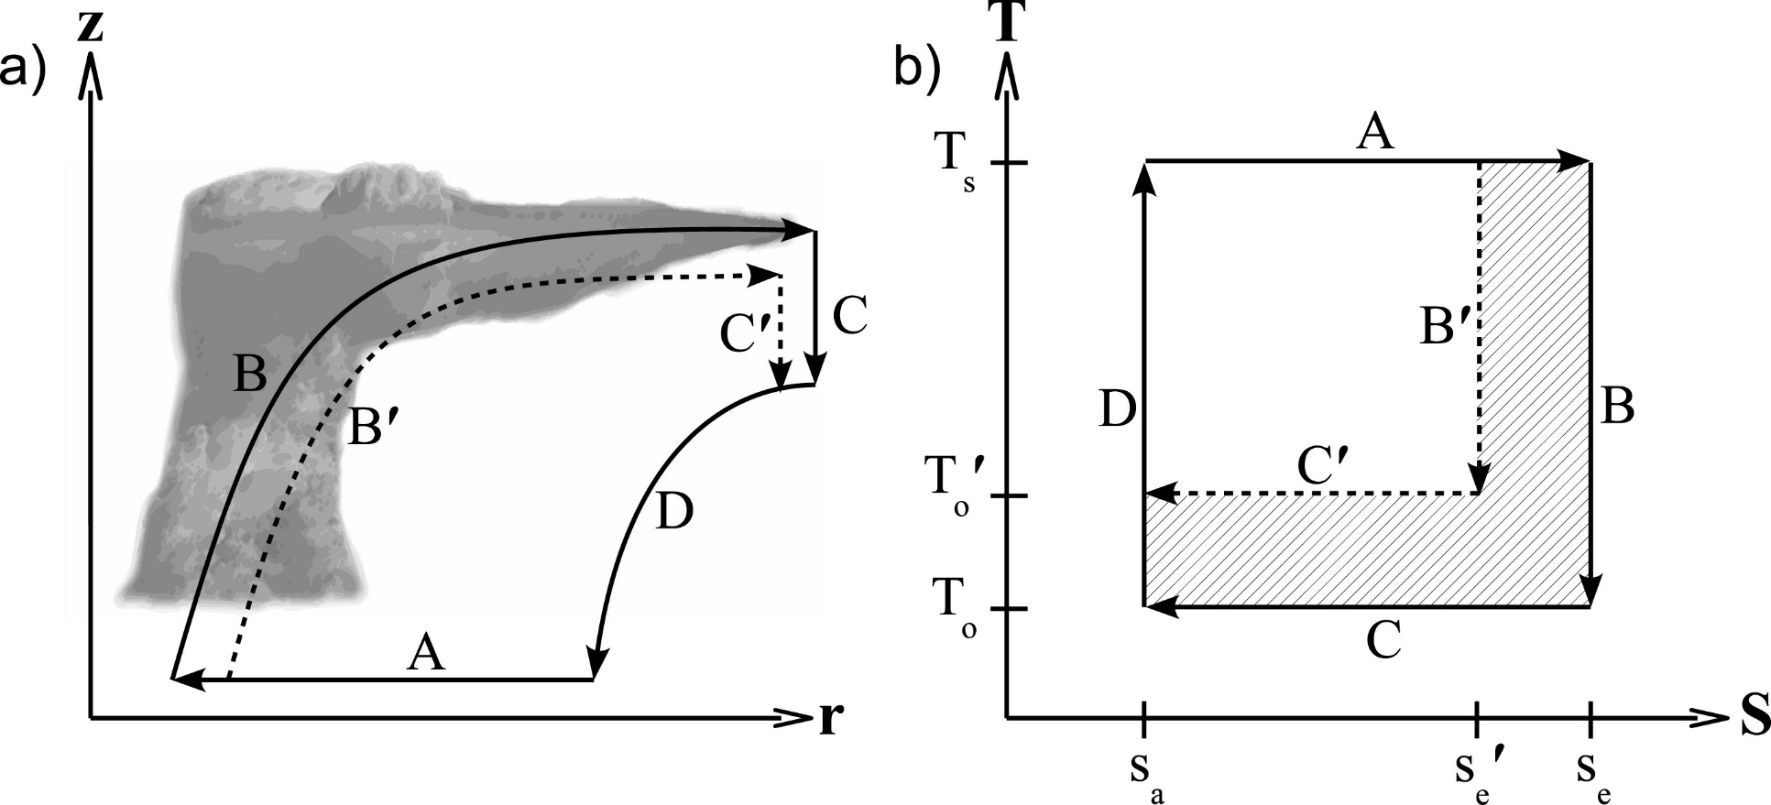
Ventilation’s Effect on the Carnot Cycle
(Figure obtained from Tang and Emanuel (2010). © 2010, American Meteorological Society.)

Slide 16
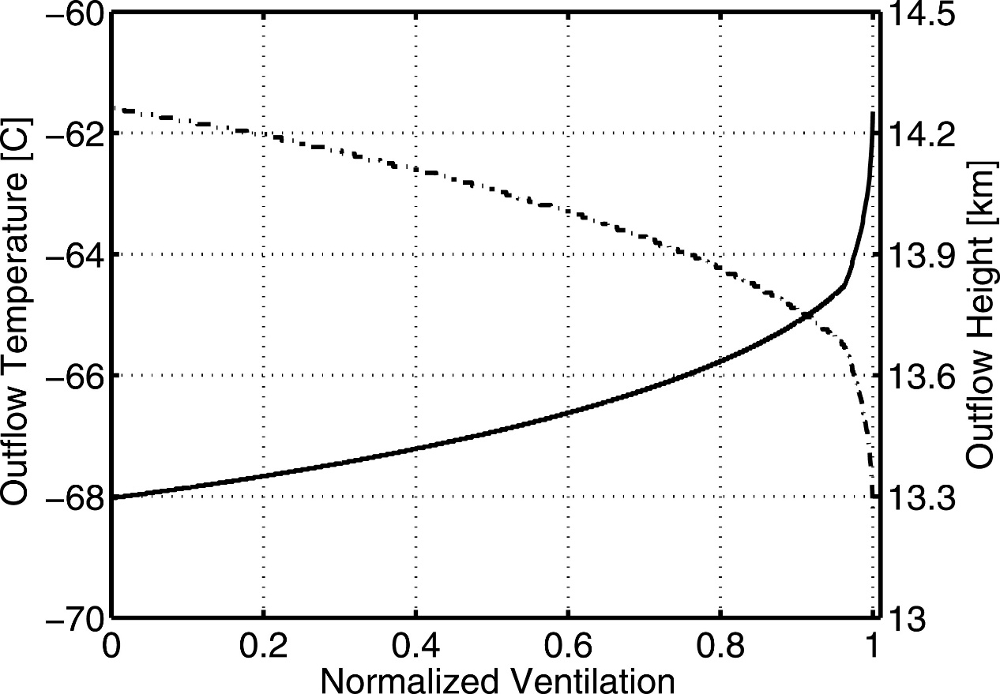
Ventilation’s Effect on Outflow Temperature
(Figure obtained from Tang and Emanuel (2010). © 2010, American Meteorological Society.)

Slide 17
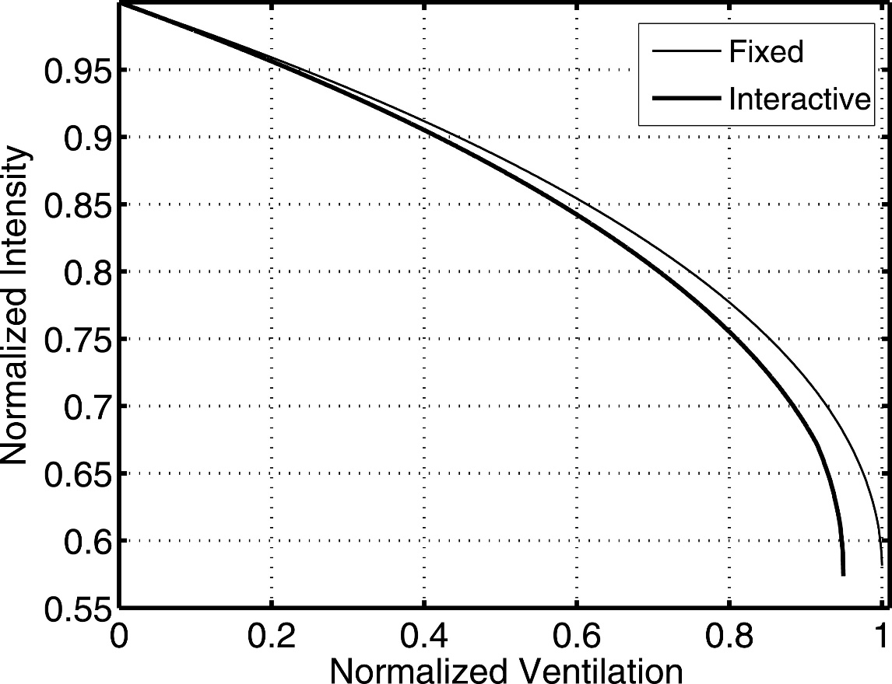
Ventilation’s Effect on Intensity
(Figure obtained from Tang and Emanuel (2010). © 2010, American Meteorological Society.)

Slide 18
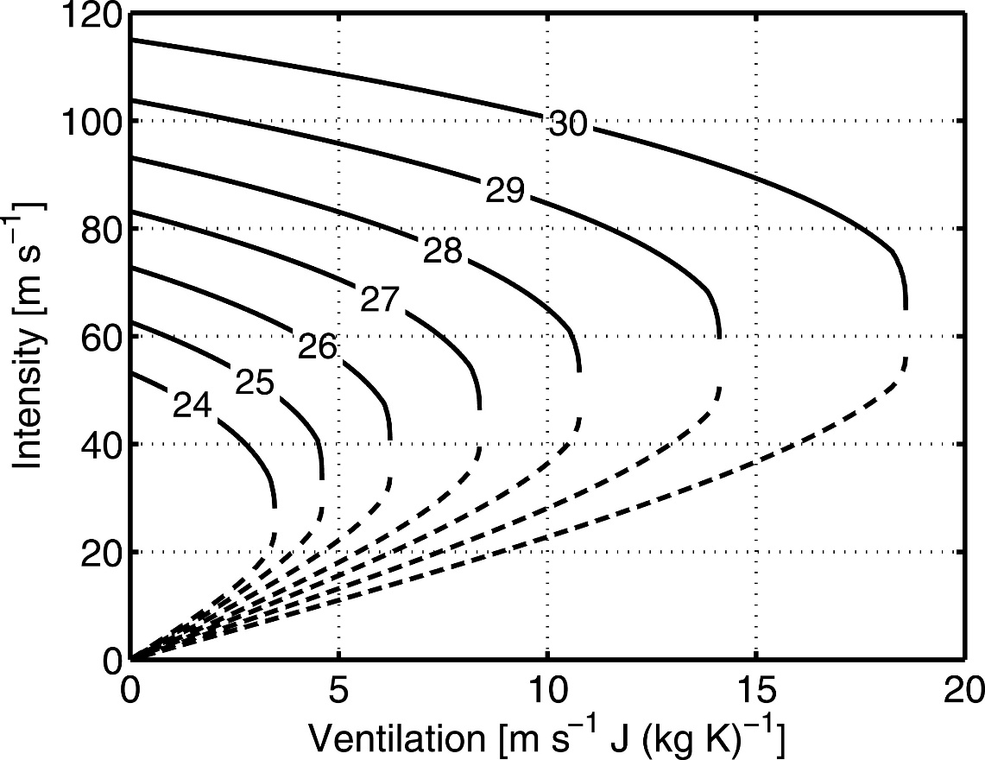
Ventilation and Intensity Sensitivity to SST
(Figure obtained from Tang and Emanuel (2010). © 2010, American Meteorological Society.)

Slide 19
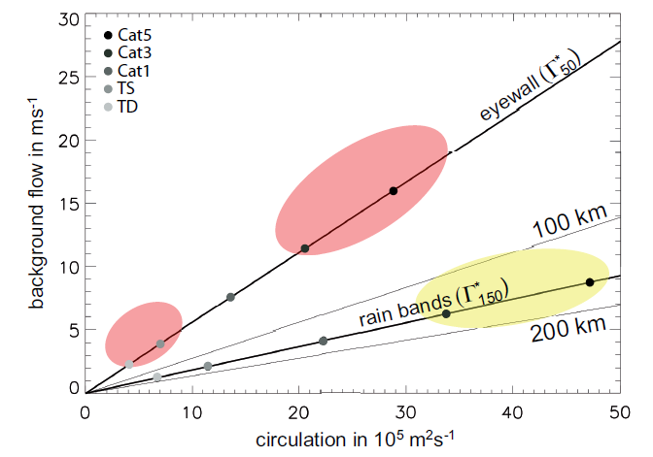
Vertical Wind Shear and TC Intensity
(Figure obtained from Riemer and Montgomery (2011). © 2011, M. Riemer and M. T. Montgomery.)

Slide 20
Ventilation Pathways
Low-Level Ventilation
Mid-Level Ventilation
No shear
15 m s⁻¹ shear
20 m s⁻¹ shear
(different shading represents different trajectory release times used to comprise these trajectories)
(Figure obtained from Riemer and Laliberté (2015). © 2015, American Meteorological Society.)

Slide 21
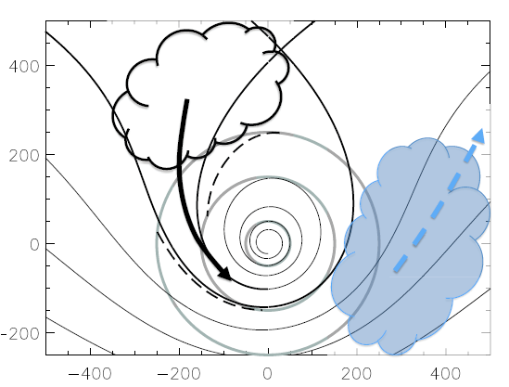
Vertical Wind Shear vs. Location of Dry Air
(Figure obtained from Riemer and Montgomery (2011). © 2011, M. Riemer and M. T. Montgomery.)

Slide 22
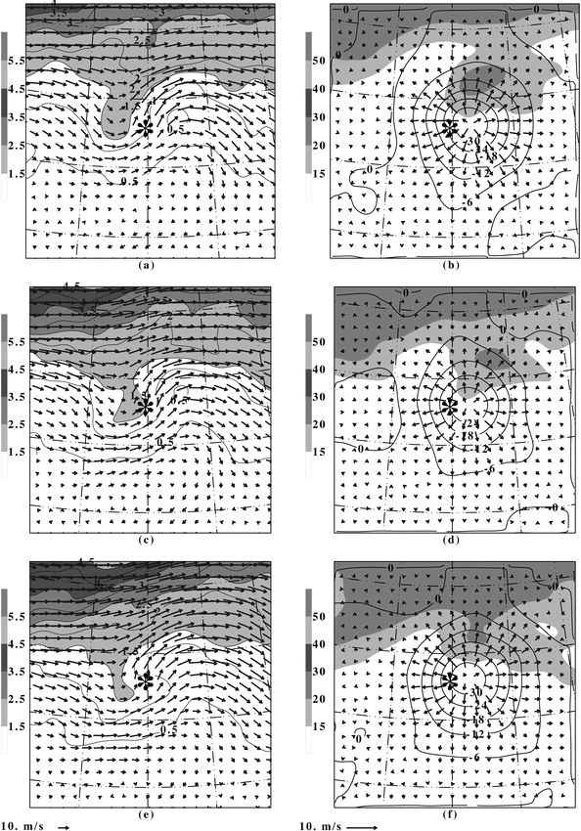
Favorable Trough Interaction
Left: PV (PVU; shaded and contoured), winds (m s⁻¹; vectors) at 200 hPa
Right: winds (m s⁻¹; shaded above 30 m s⁻¹), divergent wind (m s⁻¹; vectors), and velocity potential (contoured) at 200 hPa
t-12 h
t
t+12 h
(Figure obtained from Hanley et al. (2001). © 2001, American Meteorological Society.)

Slide 23
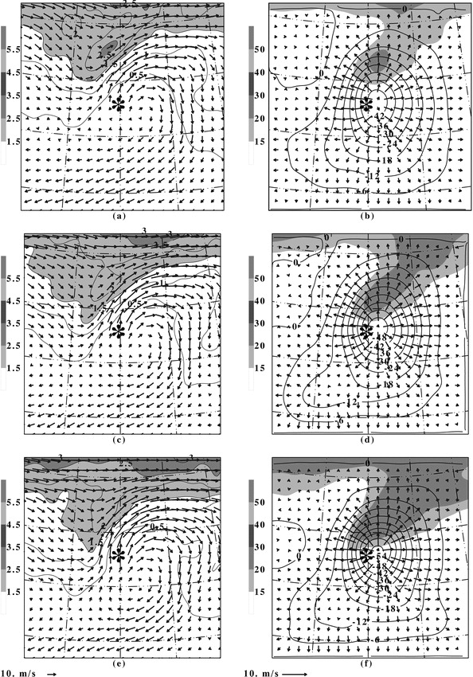
Favorable Distant Trough Interaction
Left: PV (PVU; shaded and contoured), winds (m s⁻¹; vectors) at 200 hPa
Right: winds (m s⁻¹; shaded above 30 m s⁻¹), divergent wind (m s⁻¹; vectors), and velocity potential (contoured) at 200 hPa
t-12 h
t
t+12 h
(Figure obtained from Hanley et al. (2001). © 2001, American Meteorological Society.)

Slide 24
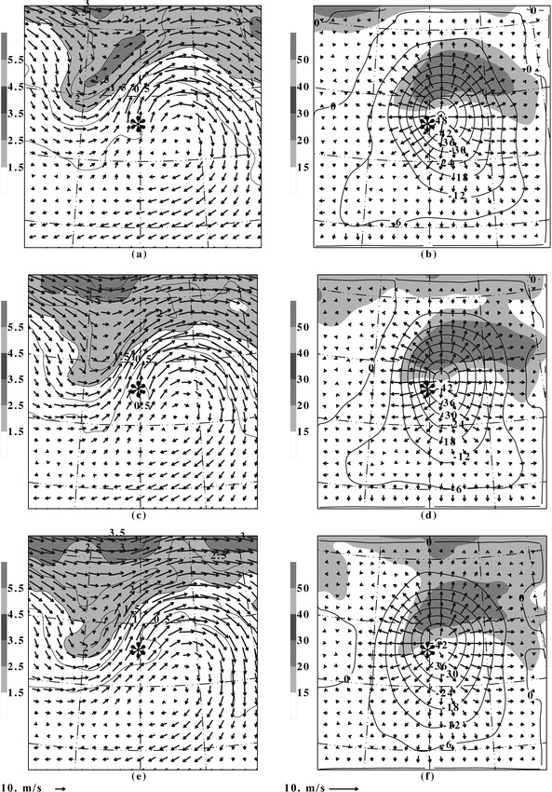
Unfavorable Distant Trough Interaction
Left: PV (PVU; shaded and contoured), winds (m s⁻¹; vectors) at 200 hPa
Right: winds (m s⁻¹; shaded above 30 m s⁻¹), divergent wind (m s⁻¹; vectors), and velocity potential (contoured) at 200 hPa
t-12 h
t
t+12 h
(Figure obtained from Hanley et al. (2001). © 2001, American Meteorological Society.)

Slide 25
Shear versus Trough Interaction
intensity change metric
Increased shear → weaker cyclone
(Figure obtained from Peirano et al. (2016). © 2016, American Geophysical Union.)

