Slide 1
Tropical Cyclone Structure

Slide 2
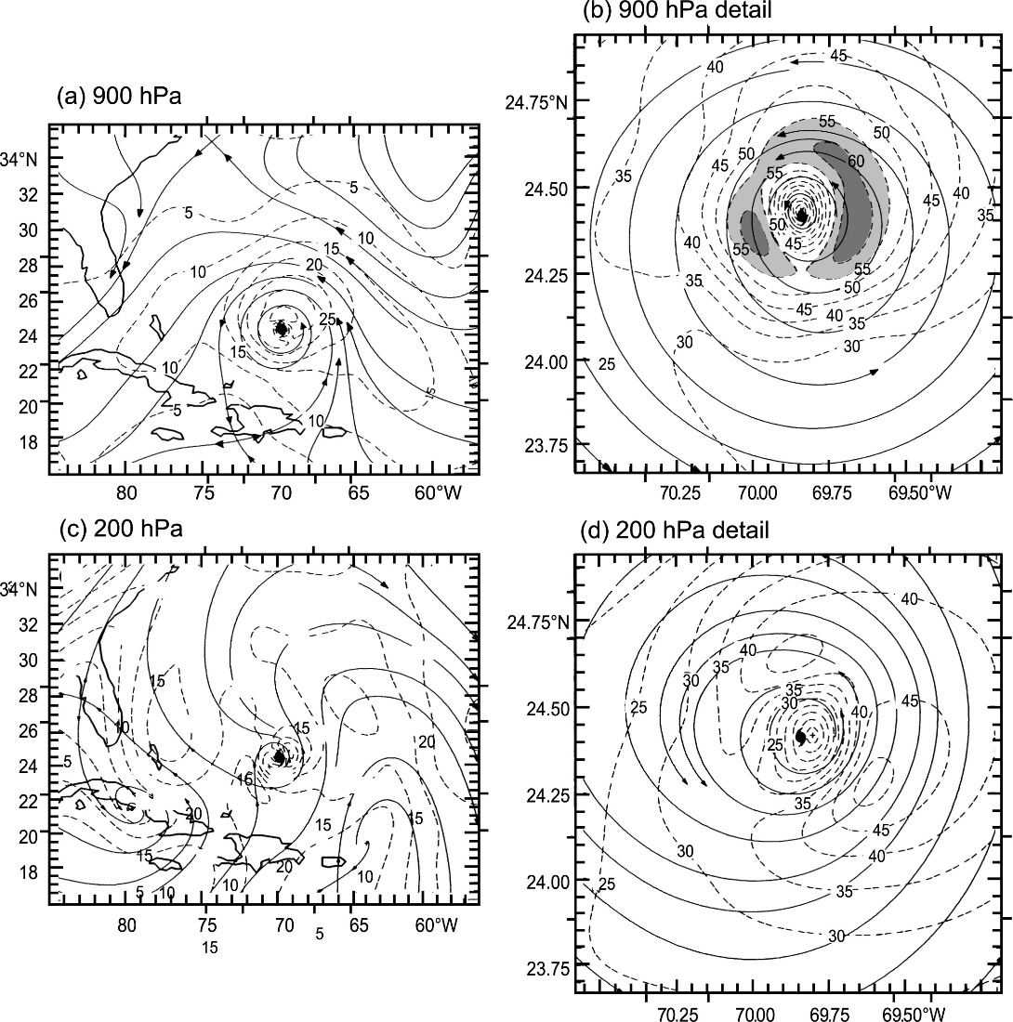
Primary Circulation Structure
(Figure obtained from Houze (2010). © 2010 American Meteorological Society.)

Slide 3
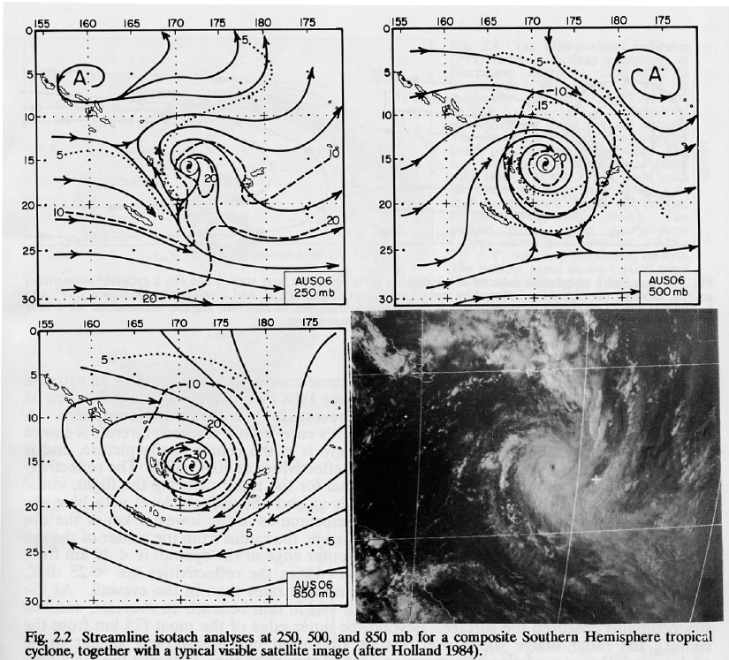
Primary Circulation Structure
(Figure obtained from Willoughby (1995). © 1995 World Meteorological Organization.)

Slide 4
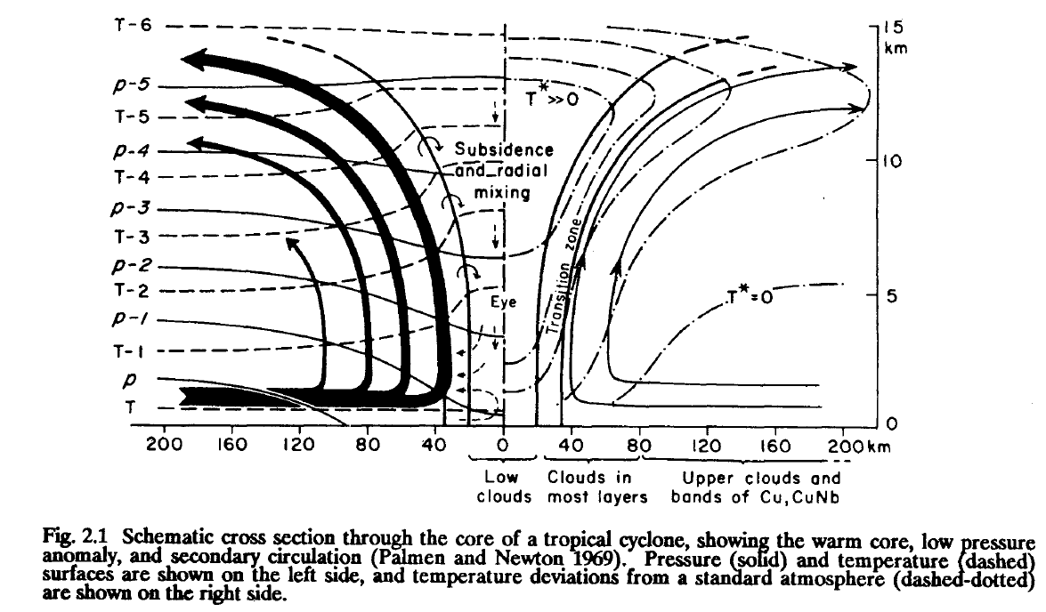
Vertical Schematic
(Figure obtained from Willoughby (1995). © 1995 World Meteorological Organization.)

Slide 5
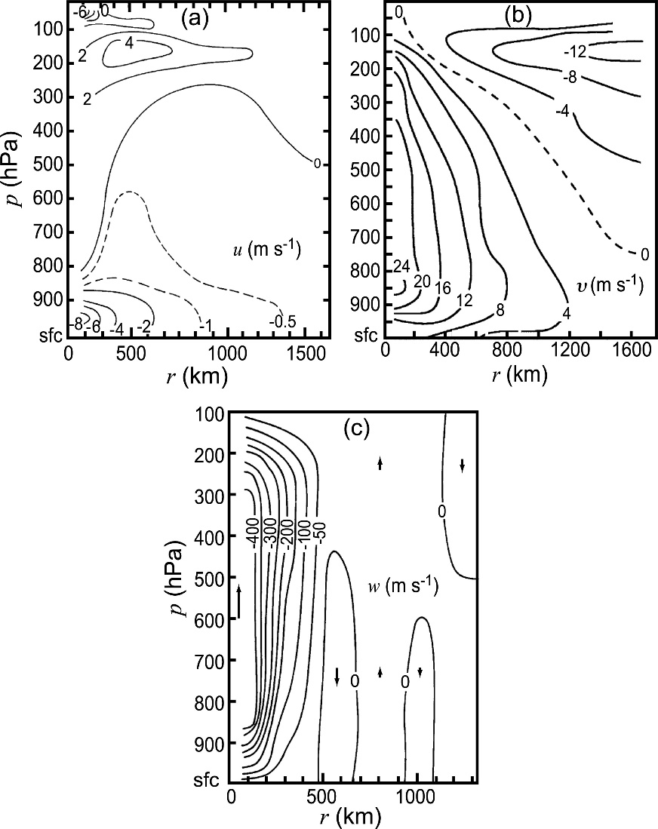
Composites of Vertical Structure
radial wind
tangential wind
vertical motion
ω (Pa s⁻¹)
(Figure obtained from Houze (2010). © 2010 American Meteorological Society.)

Slide 6
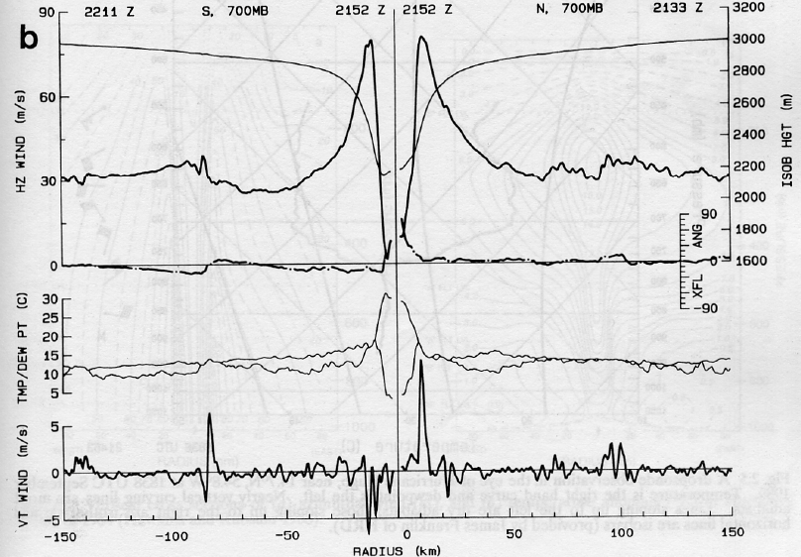
Mature Hurricane: Radial Structure
bold: 700 hPa wind (m s⁻¹)
thin: 700 hPa height (m)
top: T (°C)
bottom: Td (°C)
vertical motion
(Figure obtained from Willoughby (1995). © 1995 World Meteorological Organization.)

Slide 7
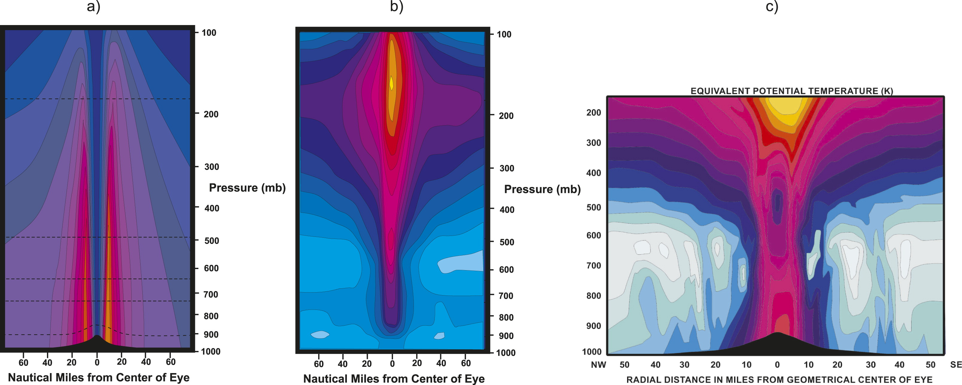
Mature Hurricane: Vertical Structure
tangential wind (kt)
temperature anomaly (K)
(Figure obtained from Emanuel (2019). © 2019, American Meteorological Society.)

Slide 8
Mature Hurricane: Vertical Structure
Suggestive of the warm thermal anomaly maximized in mid-levels.
(Figure obtained from Stern and Nolan (2012). © 2012, American Meteorological Society.)

Slide 9
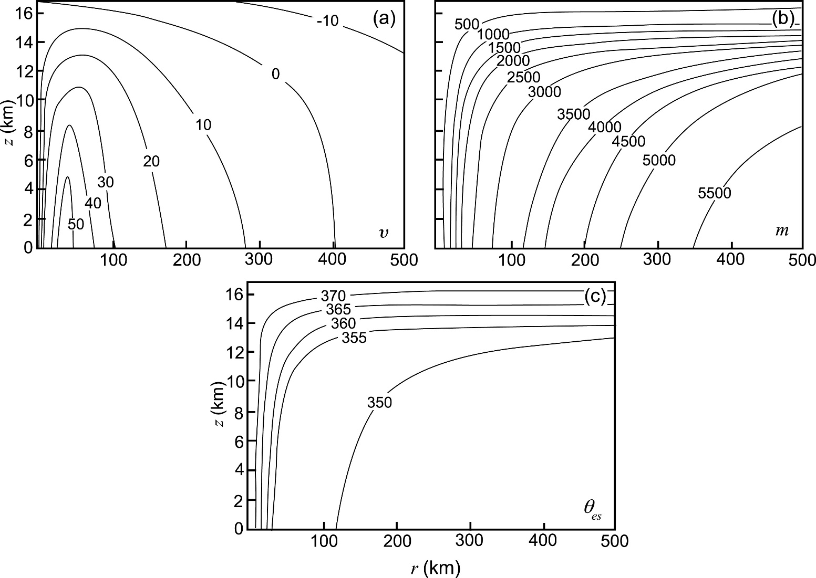
Idealized Tropical Cyclone Structure
tangential wind
angular momentum
ϴes
(Figure obtained from Houze (2010). © 2010 American Meteorological Society.)

Slide 10
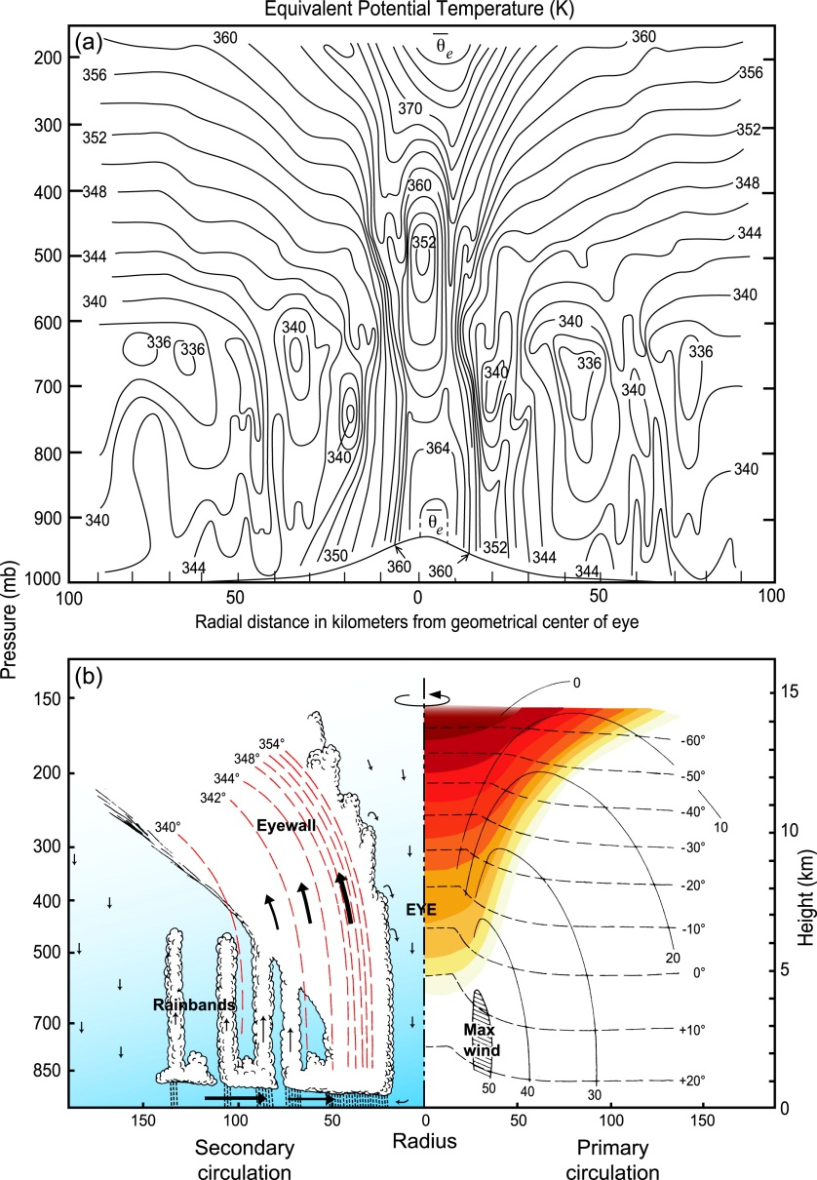
Thermodynamic Structure
(Figure obtained from Houze (2010). © 2010 American Meteorological Society.)

Slide 11
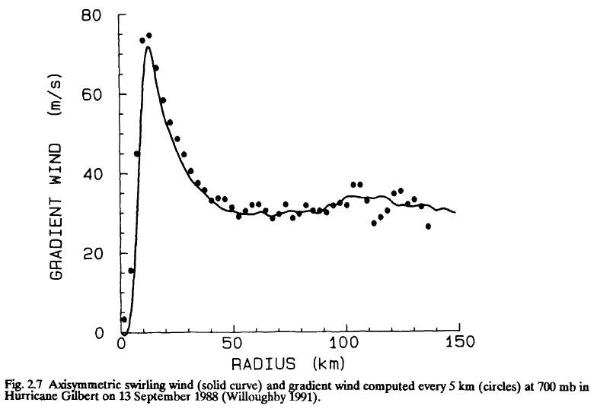
Radial Structure of Wind Profile
(Figure obtained from Willoughby (1995). © 1995 World Meteorological Organization.)

Slide 12
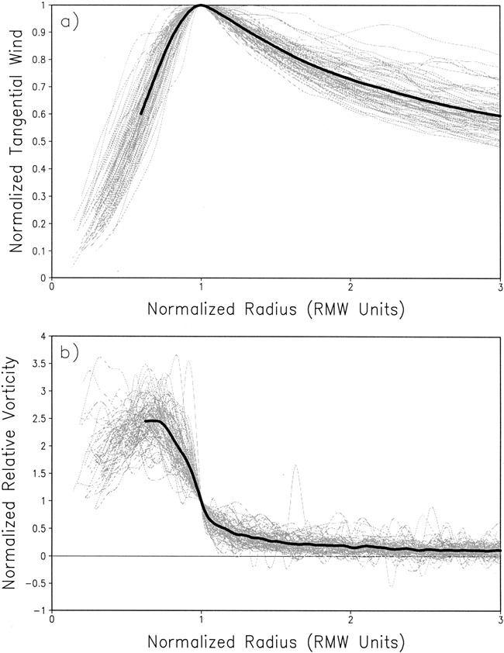
Wind and Vorticity Profile Structures
(Figure obtained from Mallen et al. (2005). © 2005 American Meteorological Society.)

Slide 13
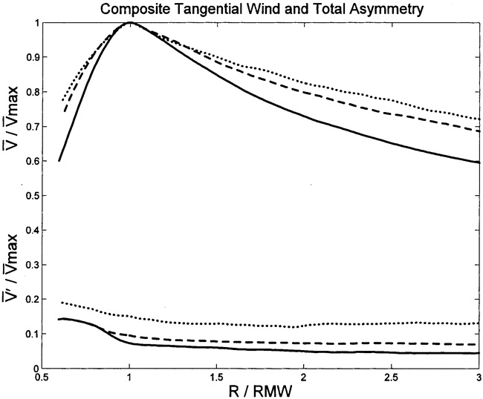
Wind Structure Variability by Intensity
(Figure obtained from Mallen et al. (2005). © 2005 American Meteorological Society.)

Slide 14
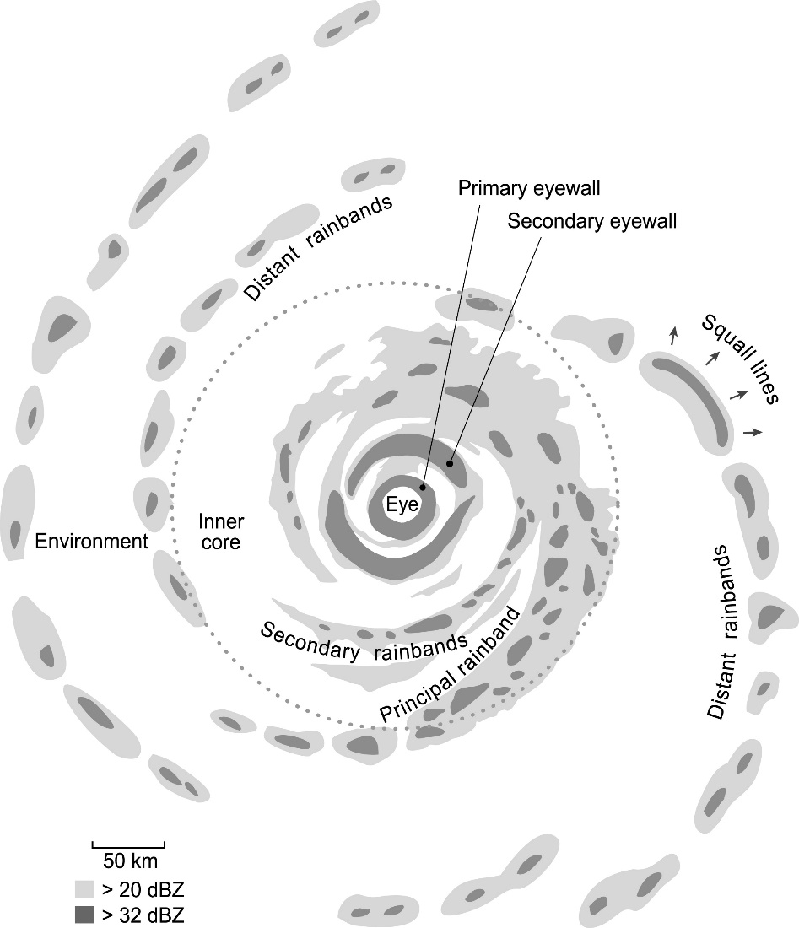
Elements of the Primary Circulation
(Figure obtained from Houze (2010). © 2010 American Meteorological Society.)

Slide 15
Eyewall and Rainband Cross-Section
(Figure obtained from Houze (2010). © 2010 American Meteorological Society.)

Slide 16
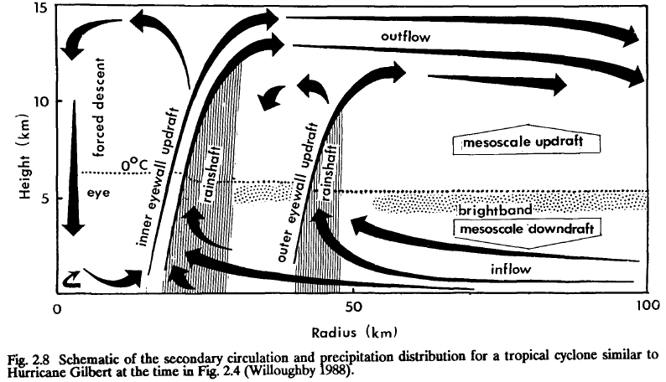
Primary and Secondary Eyewalls
(Figure obtained from Willoughby (1995). © 1995 World Meteorological Organization.)

Slide 17
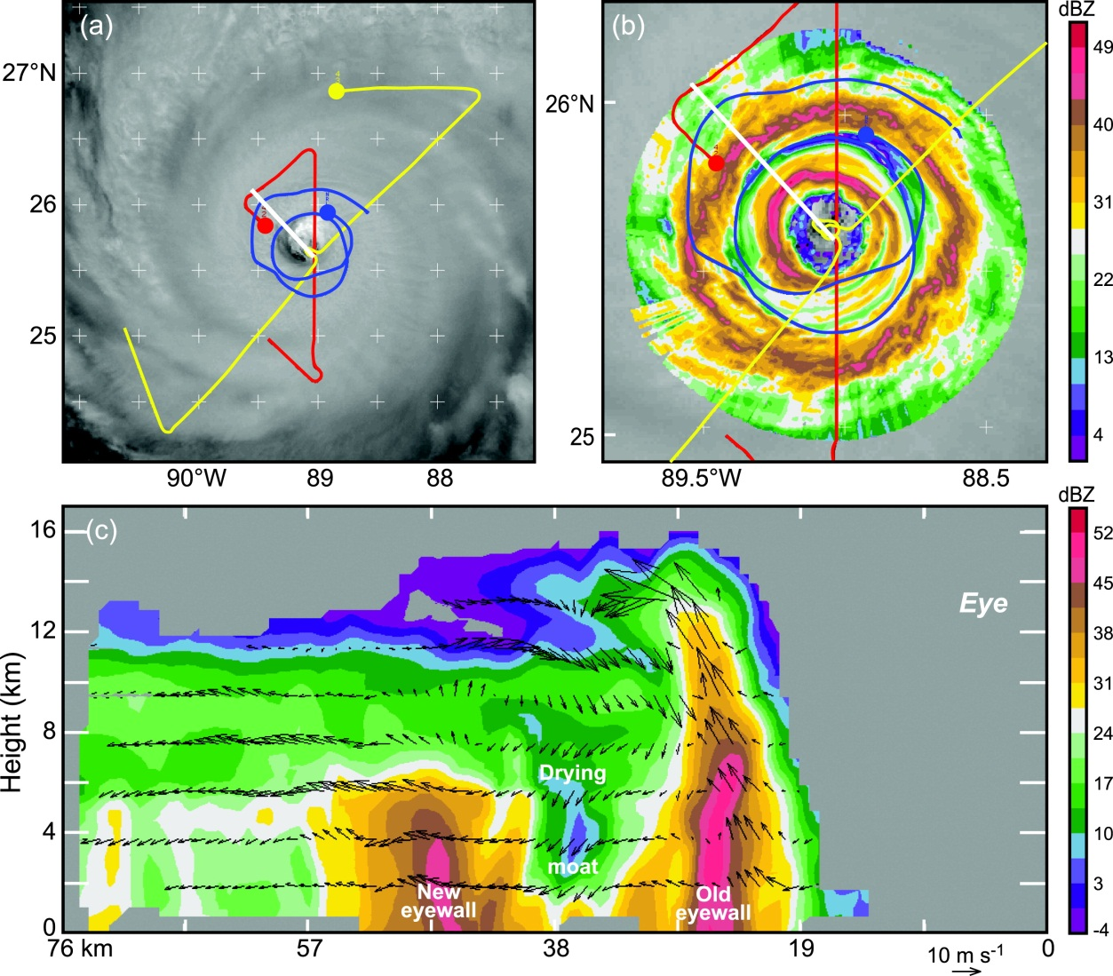
Primary and Secondary Eyewalls
(Figure obtained from Houze (2010). © 2010 American Meteorological Society.)

Slide 18
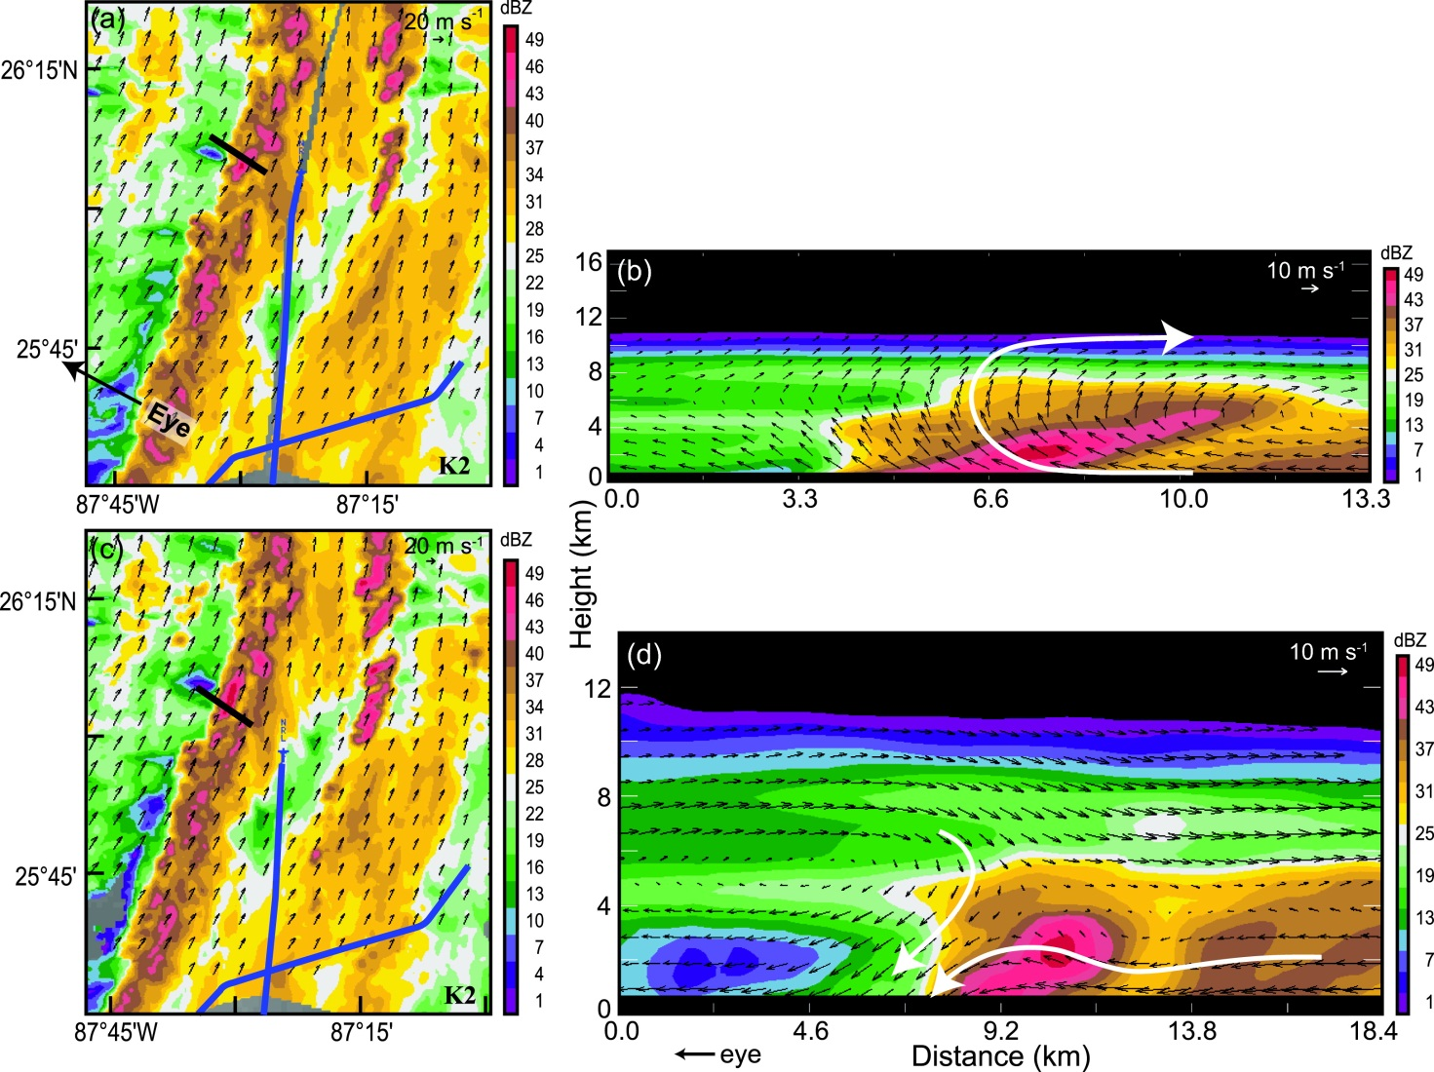
Primary Rainband Convective Structures
(Figure obtained from Houze (2010). © 2010 American Meteorological Society.)

Slide 19
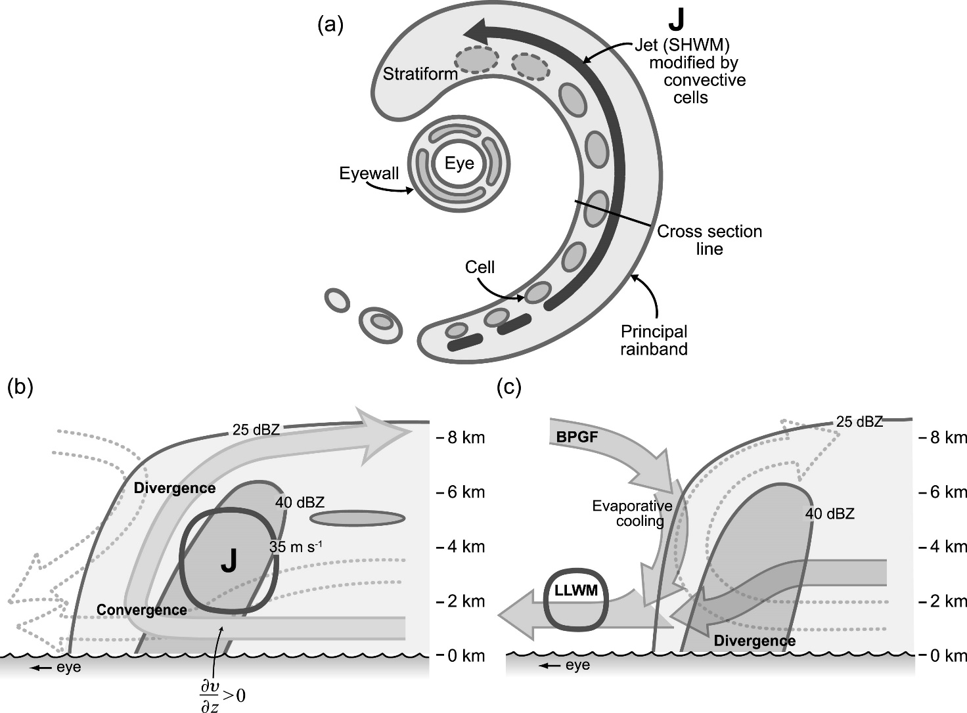
Primary Rainband Schematics
(Figure obtained from Houze (2010). © 2010 American Meteorological Society.)

Slide 20
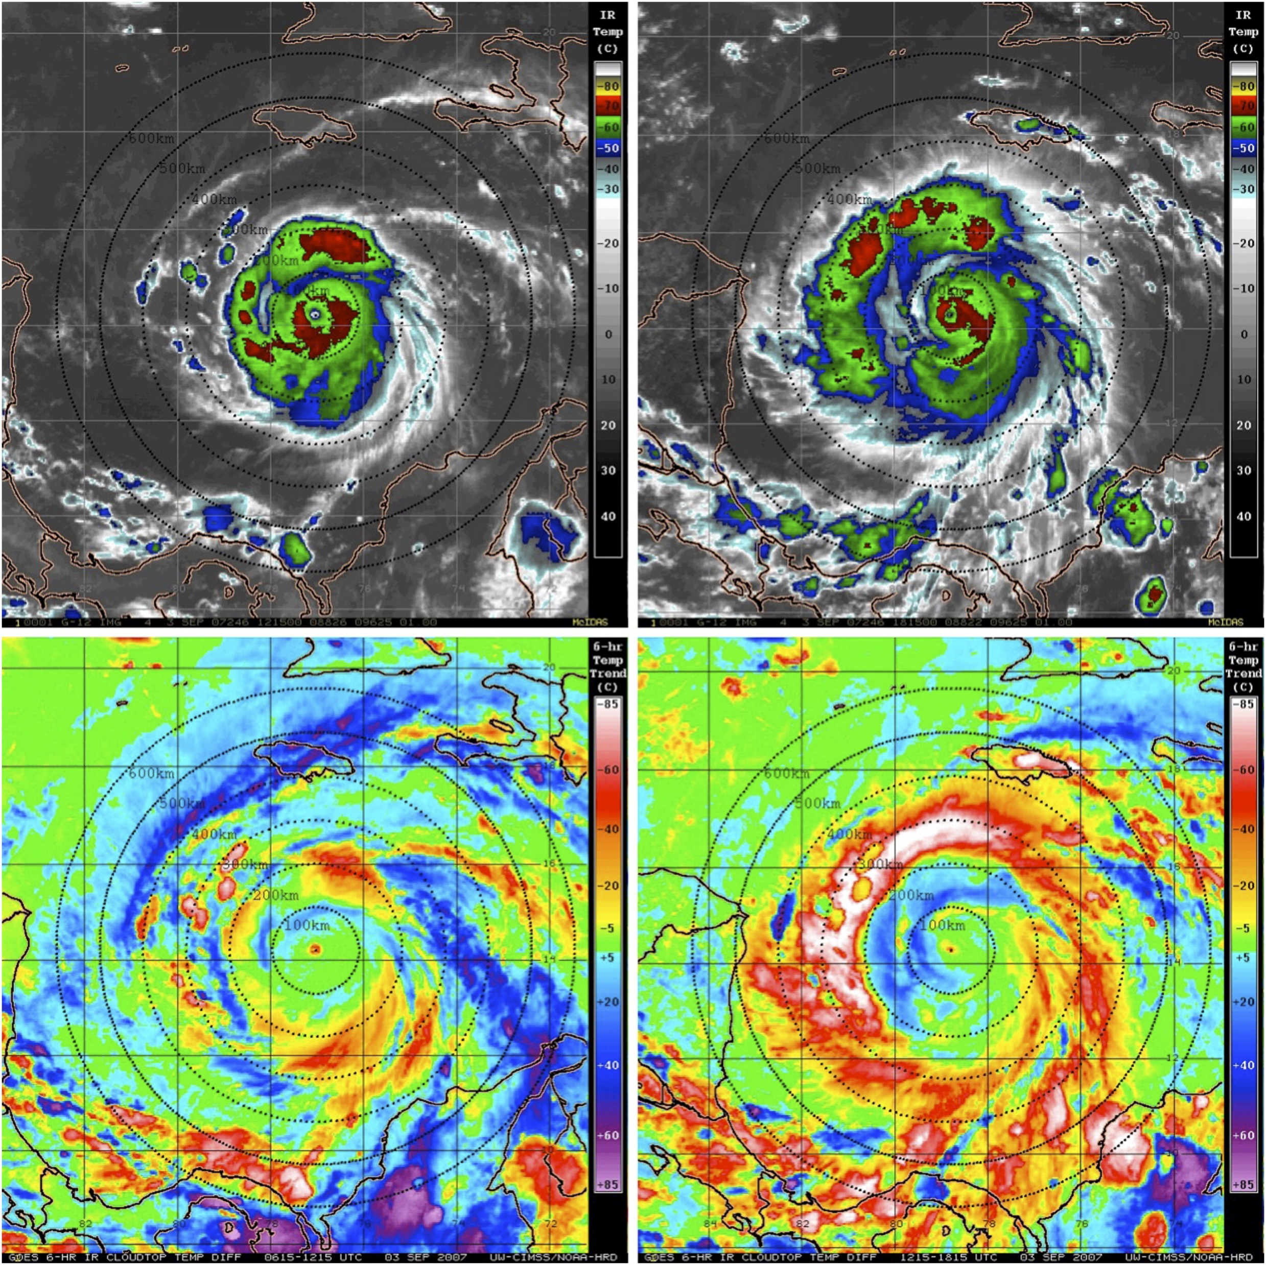
Tropical Cyclone Diurnal Cycle
Local Night
Local Daytime
Infrared Satellite
6-h Infrared Satellite Difference
(Figure obtained from Dunion et al. (2014, Mon. Wea. Rev.), their Fig. 1. © 2014, American Meteorological Society.)

Slide 21
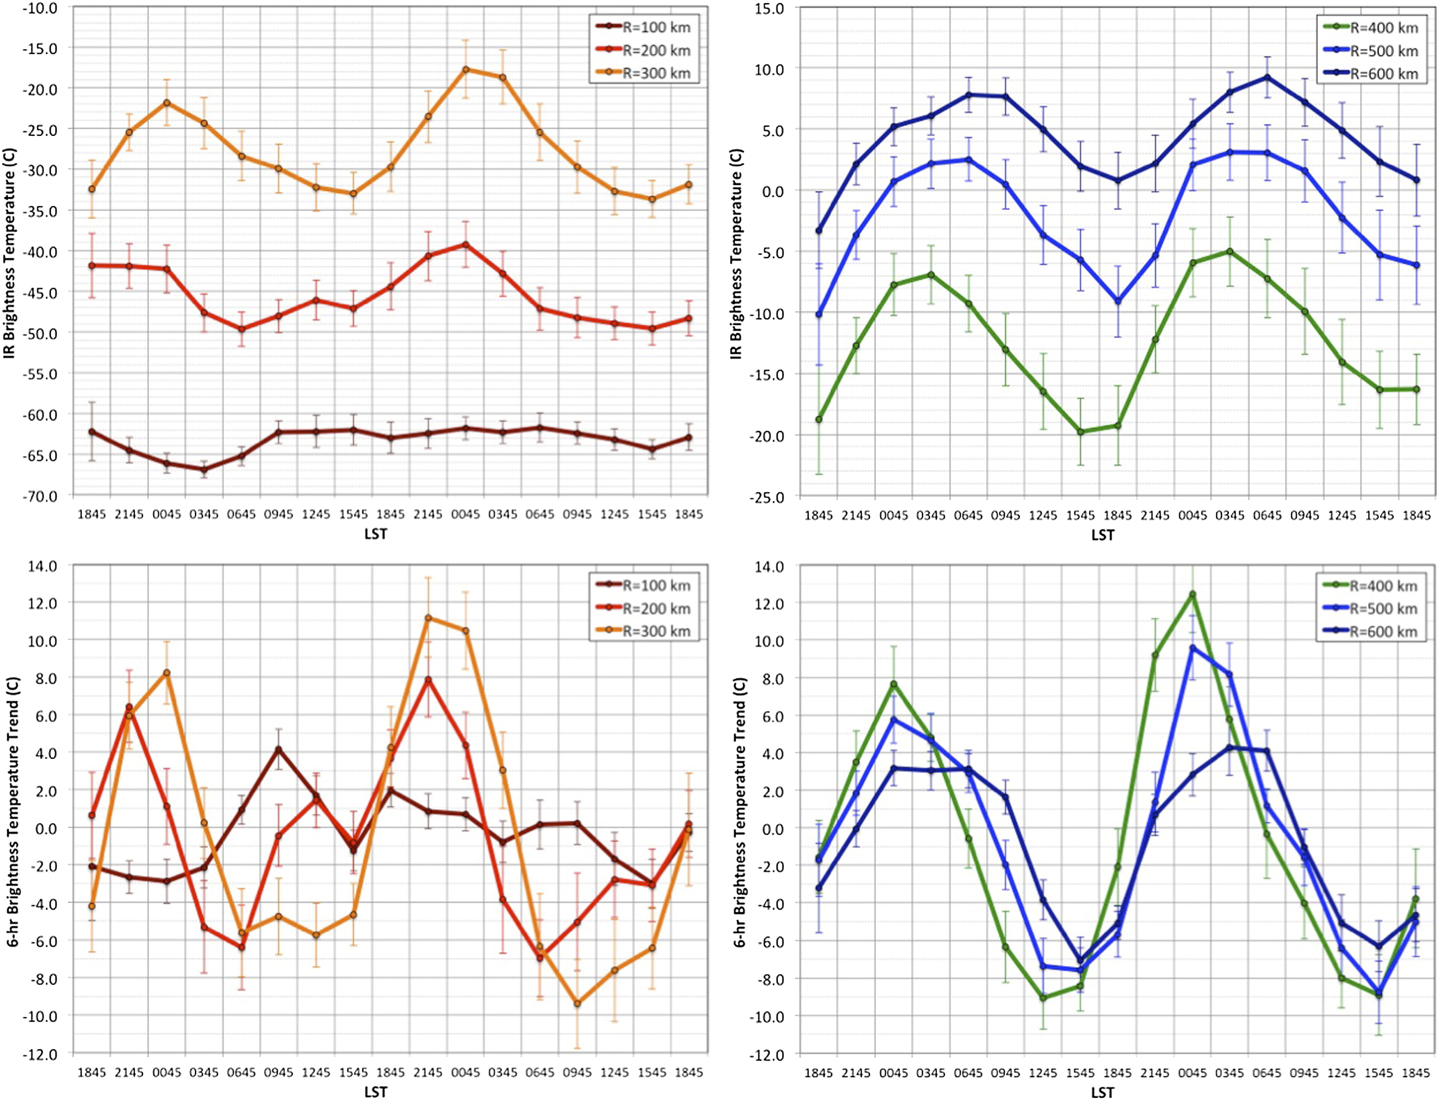
Tropical Cyclone Diurnal Cycle
Inner Core
Outer Core
Infrared Satellite Brightness Temperature
6-h Infrared Satellite Brightness Temperature Difference
(Figure obtained from Dunion et al. (2014, Mon. Wea. Rev.), their Fig. 9. © 2014, American Meteorological Society.)

Slide 22
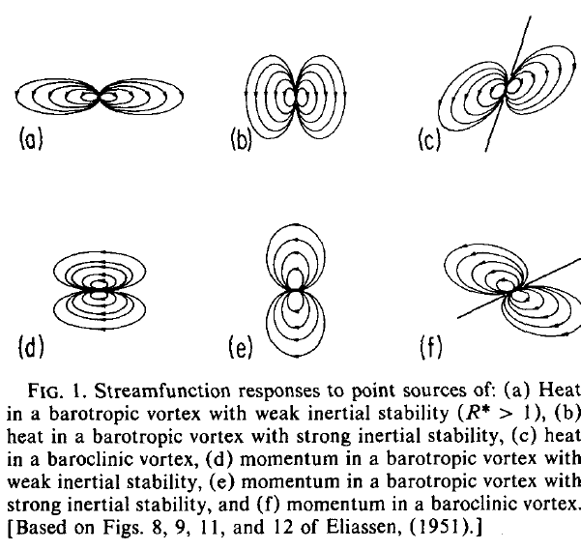
Secondary Circulation
(Figure obtained from Shapiro and Willoughby (1982). © 1982, American Meteorological Society.

Slide 23
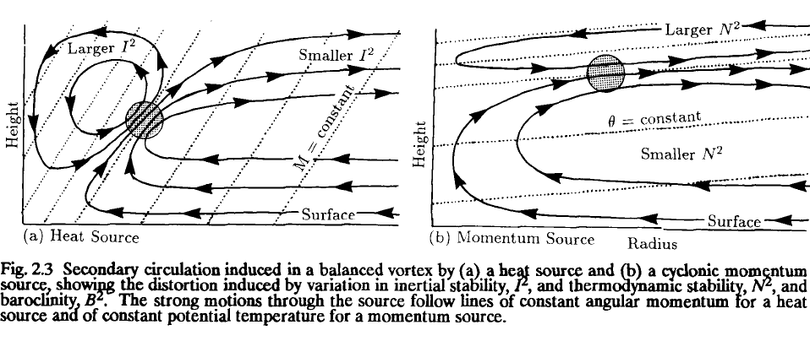
Secondary Circulation
(Figure obtained from Willoughby (1995). © 1995 World Meteorological Organization.)

Slide 24
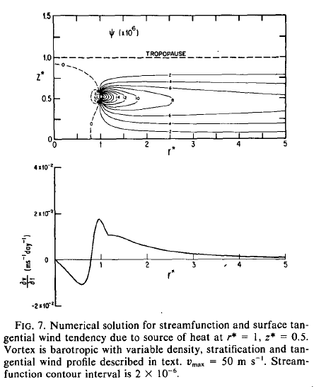
Barotropic Vortex: Heat Source Response
(Figure obtained from Shapiro and Willoughby (1982). © 1982, American Meteorological Society.

Slide 25
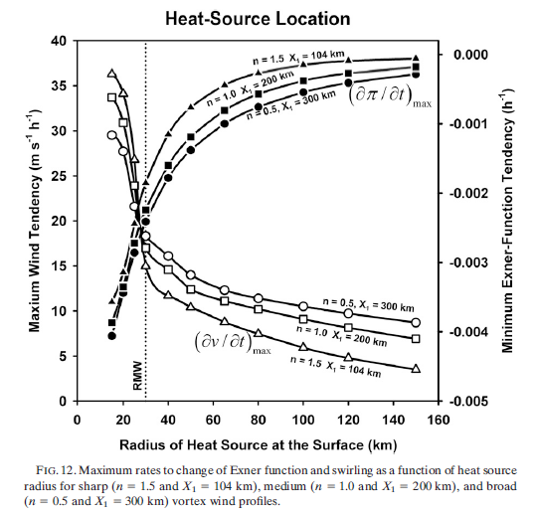
Heat Source Response: Radial Sensitivity
(Figure obtained from Pendergrass and Willoughby (2009). © 2009, American Meteorological Society.

Slide 26
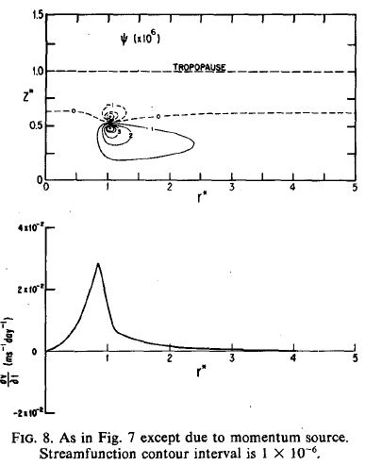
Barotropic Vortex: Momentum Source
(Figure obtained from Shapiro and Willoughby (1982). © 1982, American Meteorological Society.

Slide 27
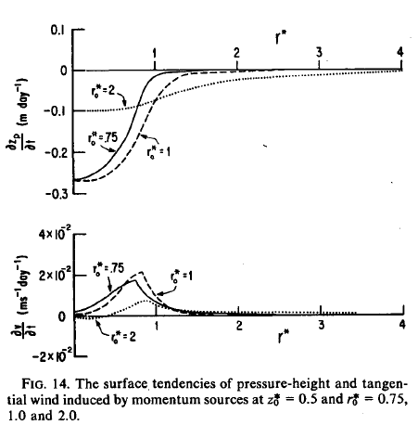
Mom. Source Response: Radial Sensitivity
(Figure obtained from Shapiro and Willoughby (1982). © 1982, American Meteorological Society.

Slide 28
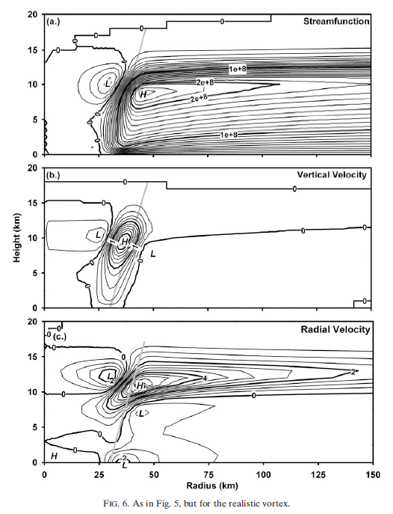
Baroclinic Vortex: Heat Source Response
(Figure obtained from Pendergrass and Willoughby (2009). © 2009, American Meteorological Society.

Slide 29
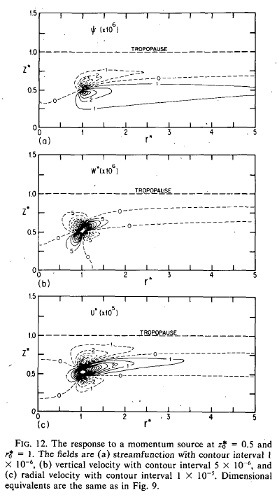
Baroclinic Vortex: Mom. Source Response
(Figure obtained from Shapiro and Willoughby (1982). © 1982, American Meteorological Society.

Slide 30
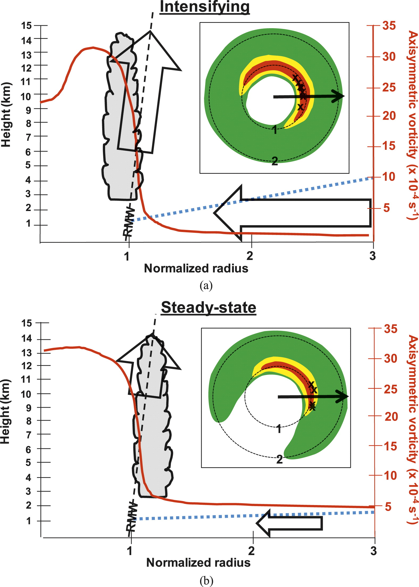
Observations of Intensifying TCs
(Figure obtained from Rogers et al. (2013, Mon. Wea. Rev.), their Fig. 16. © 2013, American Meteorological Society.

Slide 31
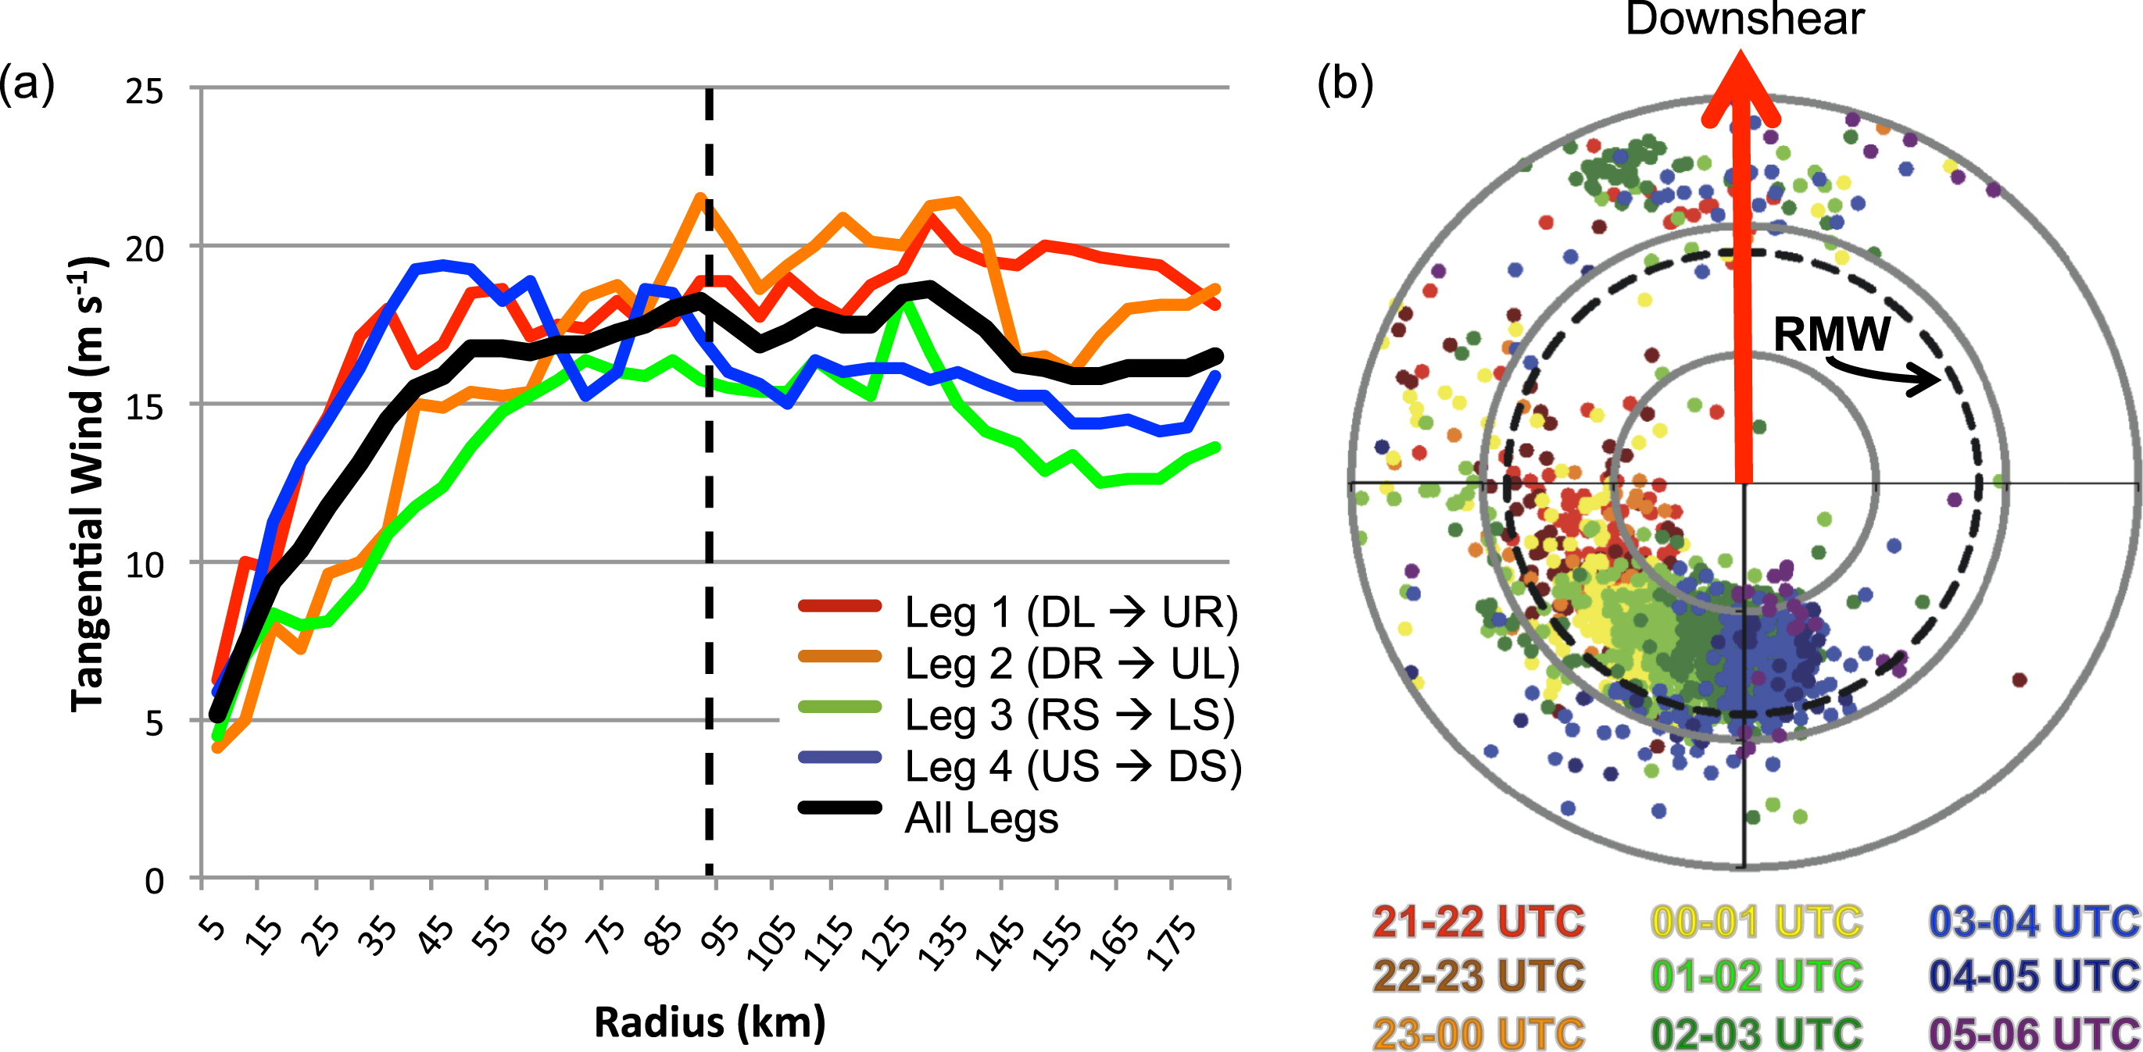
Observations of Intensifying TCs
(Figure obtained from Stevenson et al. (2014, Mon. Wea. Rev.), their Fig. 6. © 2014, American Meteorological Society.

Slide 32
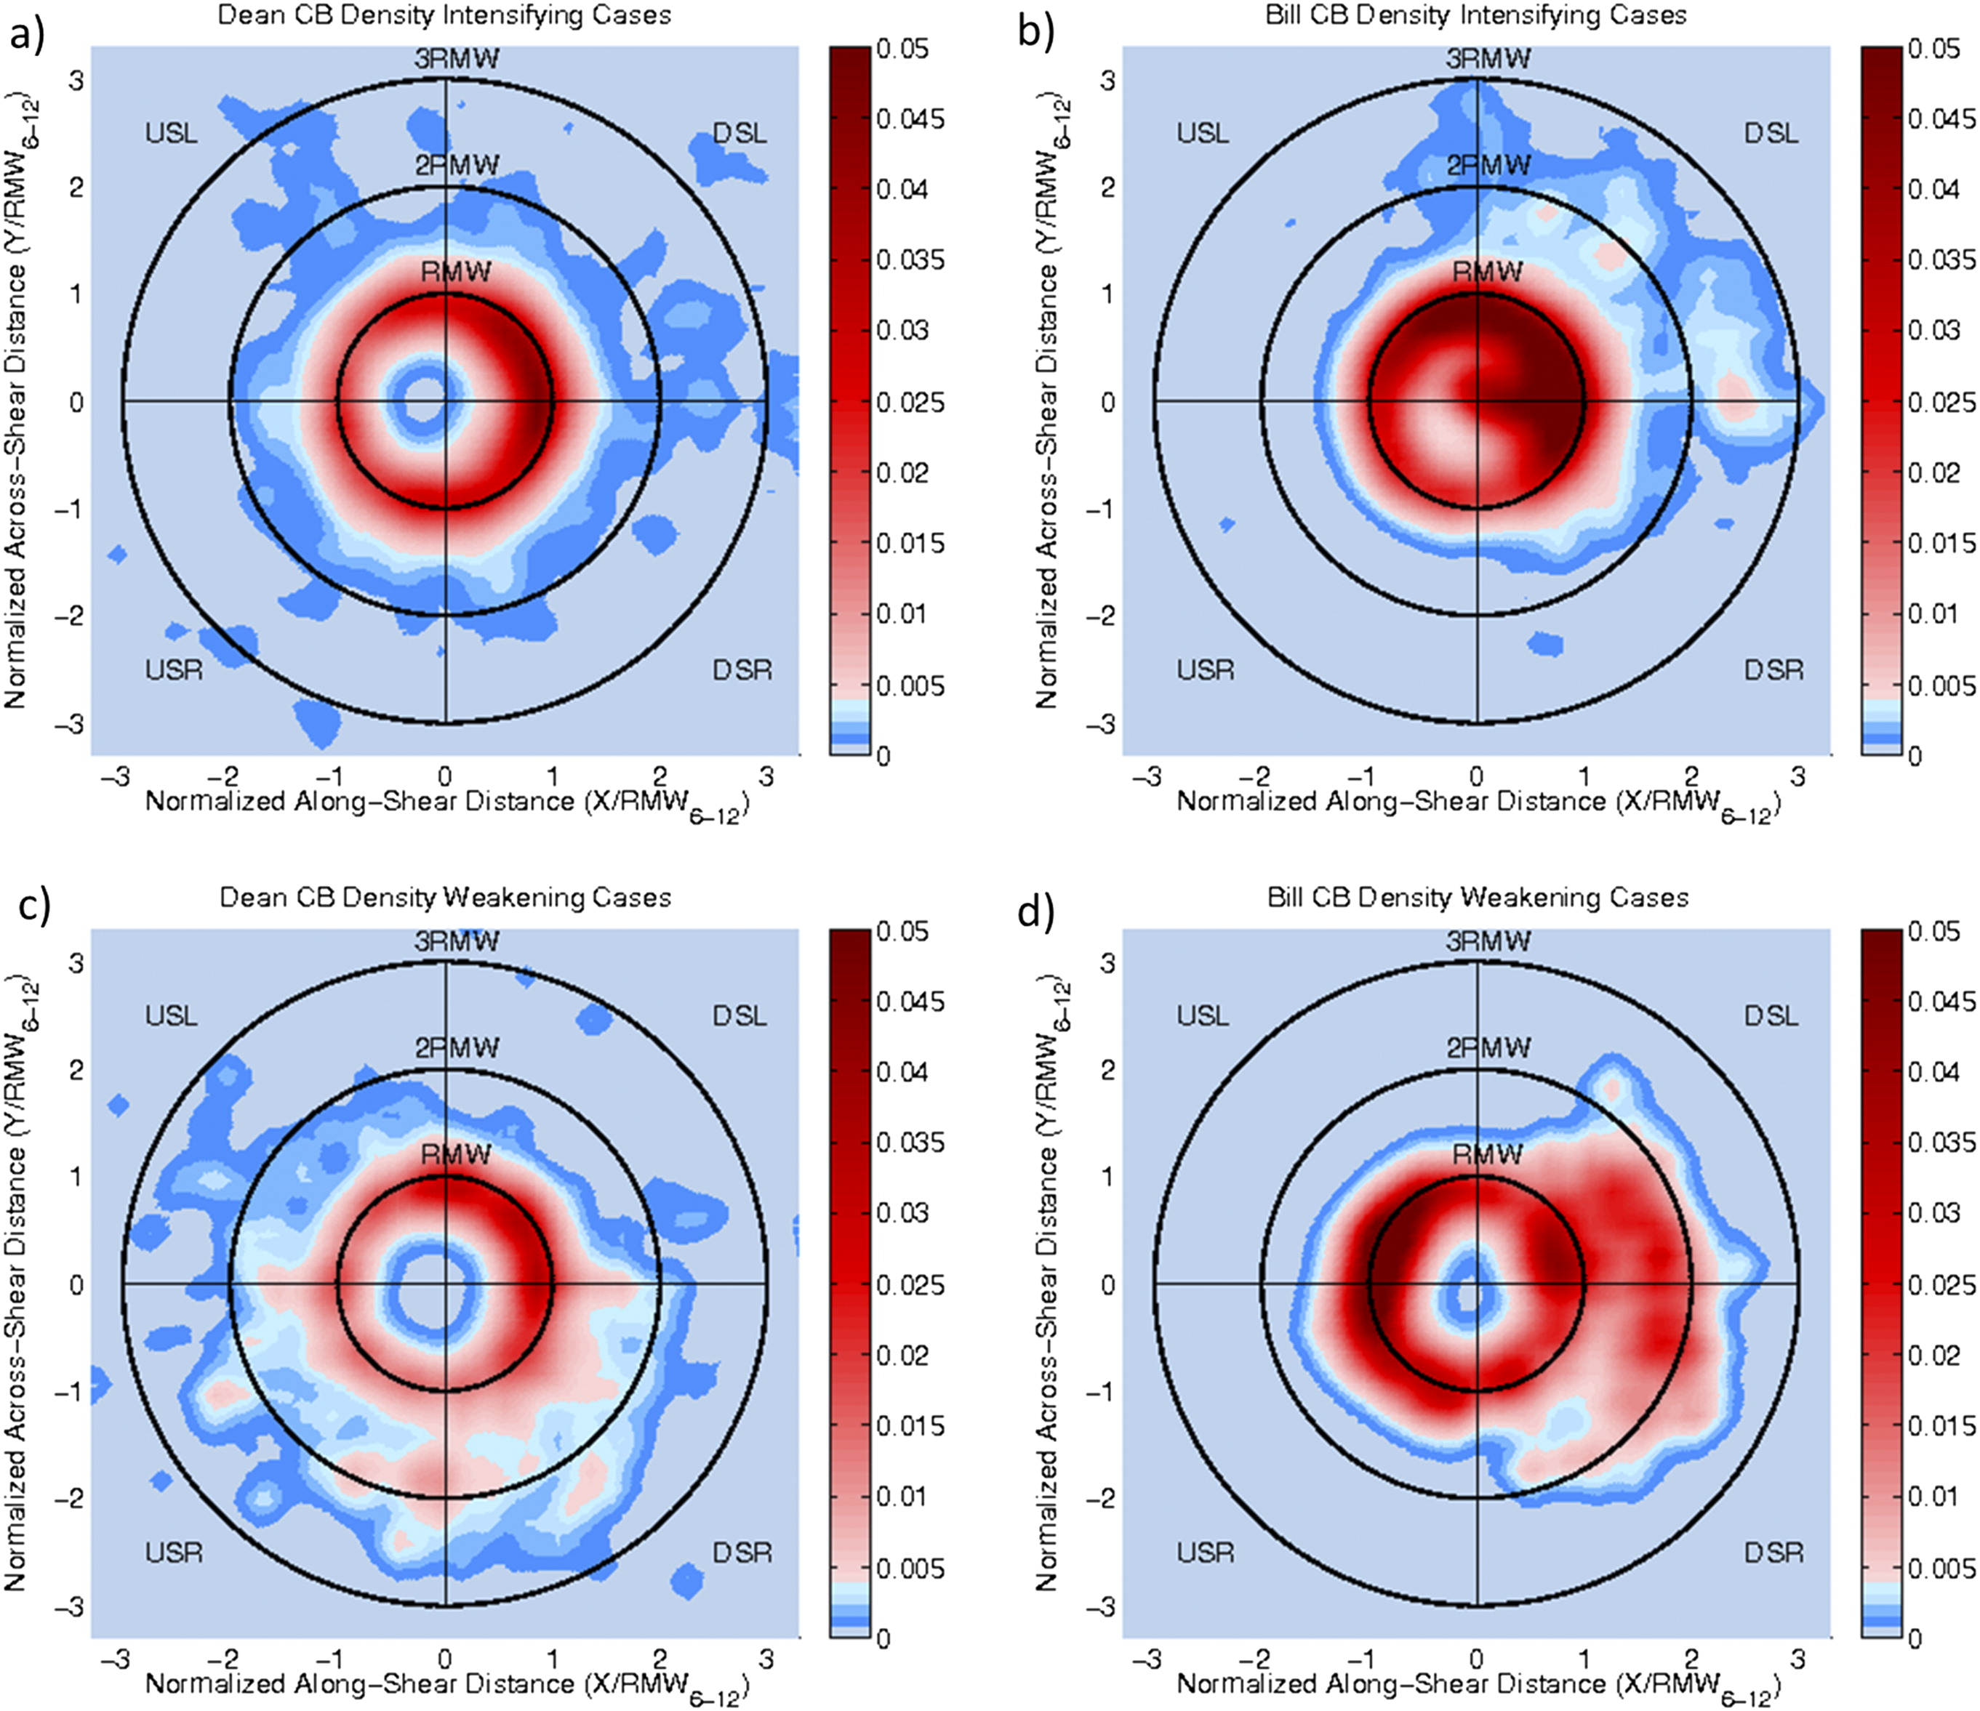
Simulations of Intensifying TCs
(Figure obtained from Hazelton et al. (2017, Mon. Wea. Rev.), their Fig. 3. © 2017, American Meteorological Society.

