Slide 1
Climatology of the Tropics

Slide 2
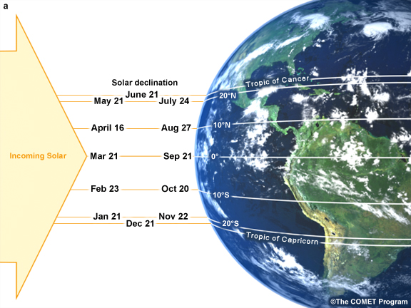
Potential Definitions of the Tropics
“The range of latitudes where the sun can be directly overhead at any point during the year.”
(Figure obtained from Introduction to Tropical Meteorology, 2nd Edition, © 2011 COMET.)

Slide 3
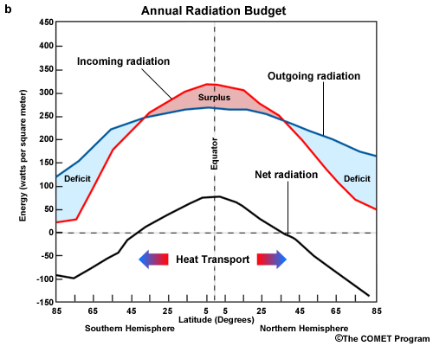
Potential Definitions of the Tropics
“The range of latitudes where the net annual incoming solar radiation is greater than the net annual outgoing terrestrial radiation. ”
(Figure obtained from Introduction to Tropical Meteorology, 2nd Edition, © 2011 COMET.)

Slide 4
Potential Definitions of the Tropics
“…the latitudes at which the Coriolis force, horizontal temperature differences, and horizontal pressure differences are all relatively weak…”
Why might these all be weak in the tropics?
What implications do they have upon the climatology of the tropics?

Slide 5
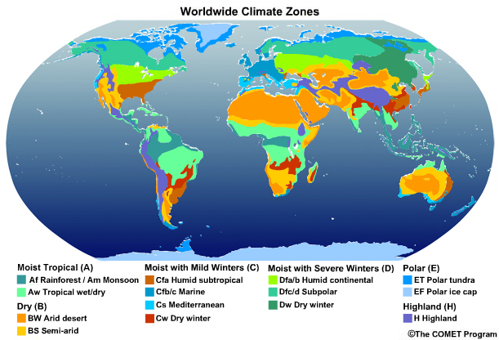
Potential Definitions of the Tropics
“The range of latitudes characterized by a tropical climate, with warm temperatures all year and either a single wet season or separate wet/dry seasons.”
(Figure obtained from Introduction to Tropical Meteorology, 2nd Edition, © 2011 COMET.)

Slide 6
Discussion Question
Assume that incoming solar radiation is at a maximum at the equator and decreases to the north and south…
What is the meridional temperature distribution that results from this situation?
Assuming that this temperature distribution holds throughout the troposphere, from thickness arguments, what is the resulting meridional distribution of surface pressure?
Where might one expect rising motion under such conditions?

Slide 7
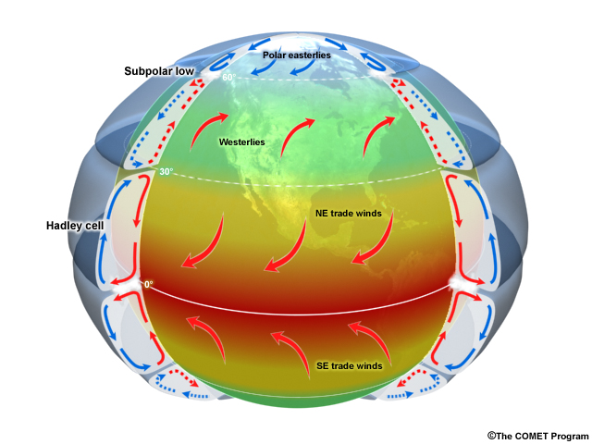
Potential Definitions of the Tropics
“The region of tropospheric ascent, easterly boundary-layer flow, and lower surface pressures associated with a meridional circulation centered near the Equator.”
(Figure obtained from Introduction to Tropical Meteorology, 2nd Edition, © 2011 COMET.)

Slide 8
Climate Zones of the World
(Figure obtained from Introduction to Tropical Meteorology, 2nd Edition, © 2011 COMET.)

Slide 9
Influences Upon Surface Temperatures
(Figure obtained from Introduction to Tropical Meteorology, 2nd Edition, © 2011 COMET.)

Slide 10
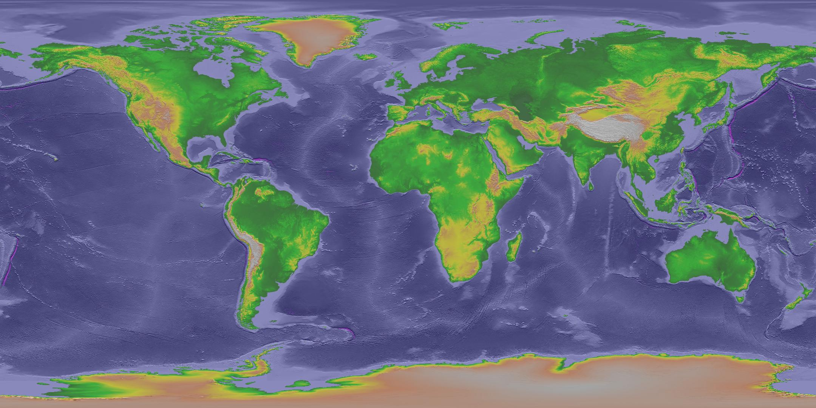
Influences Upon Surface Temperatures
(Figure obtained from NOAA/National Geophysical Data Center, https://www.ngdc.noaa.gov/mgg/topo/globega2.html)

Slide 11
Annual Range of Surface Temperatures
Figure obtained using the freely available NCEP-DOE Reanalysis II dataset.

Slide 12
Mean 200 hPa Streamlines: SH Summer
Pacific jet
S. American anticyclone
African anticyclone
Australian anticyclone
Mid-oceanic troughs
Figures obtained using the freely available NCEP-DOE Reanalysis II dataset.

Slide 13
Mean 850 hPa Streamlines: SH Summer
Easterly trade winds
Australian Monsoon
Heat low
Amplified subtropical ridging in summer hemisphere
Figures obtained using the freely available NCEP-DOE Reanalysis II dataset.
Notes:
Why might the signs of the major circulatory features differ from those at 200 hPa?

Slide 14
Mean 200 hPa Streamlines: NH Summer
Easterly jet over Africa
and Indian Ocean
Monsoon gyre (Indian anticyclone)
Mid-oceanic troughs
Subtropical ridge over Africa
Figures obtained using the freely available NCEP-DOE Reanalysis II dataset.
Notes:
Why might troughs be favored over the relatively cool oceans during local summer? Why might ridges be favored over the relatively warm landmasses during local summer?

Slide 15
Mean 850 hPa Streamlines: NH Summer
Monsoonal
depression
Amplified subtropical ridging in summer hemisphere
Heat low
Indian/Asian Monsoon
Easterly trade winds
Figures obtained using the freely available NCEP-DOE Reanalysis II dataset.
Notes:
Why might the signs of the major circulatory features differ from those at 200 hPa?

Slide 16
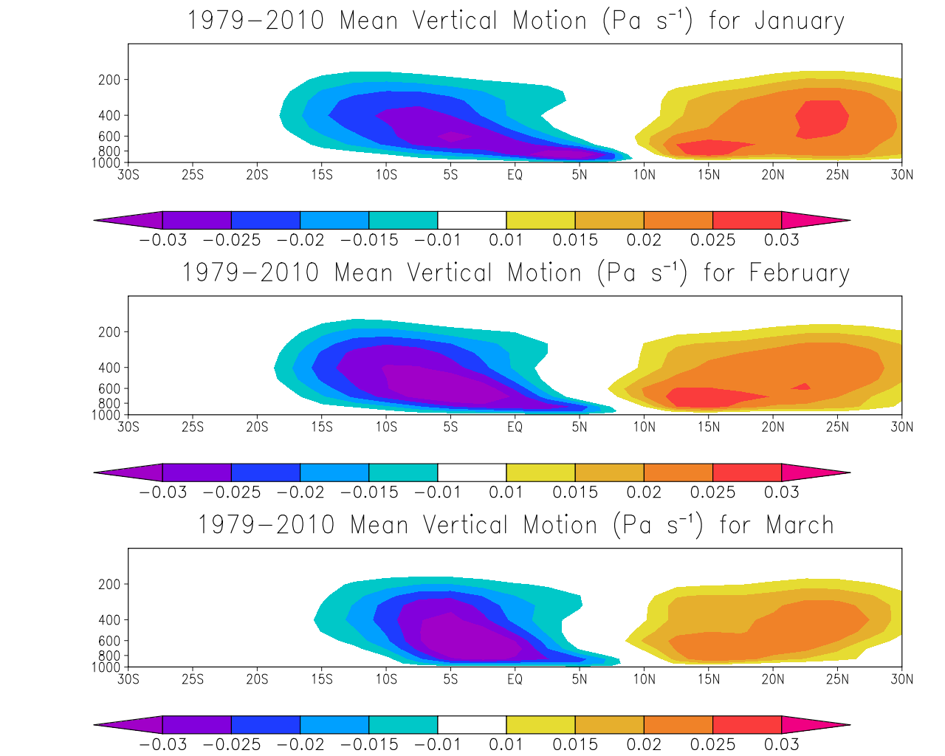
Mean Vertical Motion: Jan-Mar
pressure (hPa)
pressure (hPa)
pressure (hPa)
Figures obtained using the freely available NCEP-DOE Reanalysis II dataset.

Slide 17
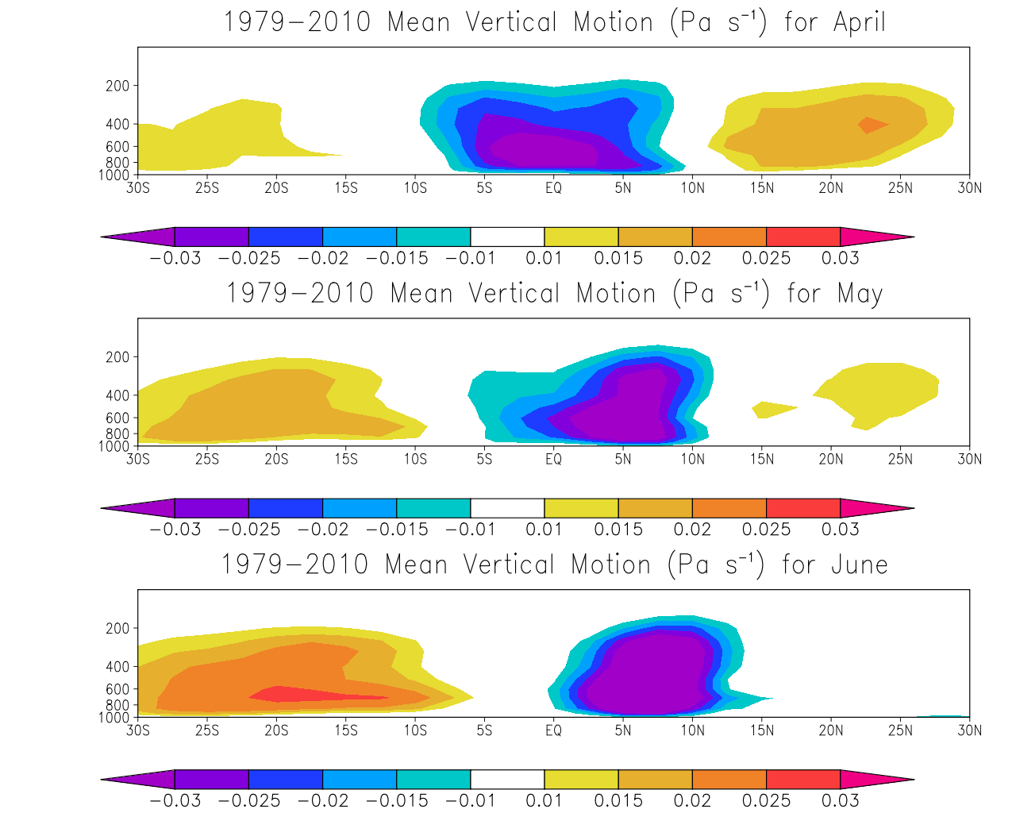
Mean Vertical Motion: Apr-Jun
pressure (hPa)
pressure (hPa)
pressure (hPa)
Figures obtained using the freely available NCEP-DOE Reanalysis II dataset.

Slide 18
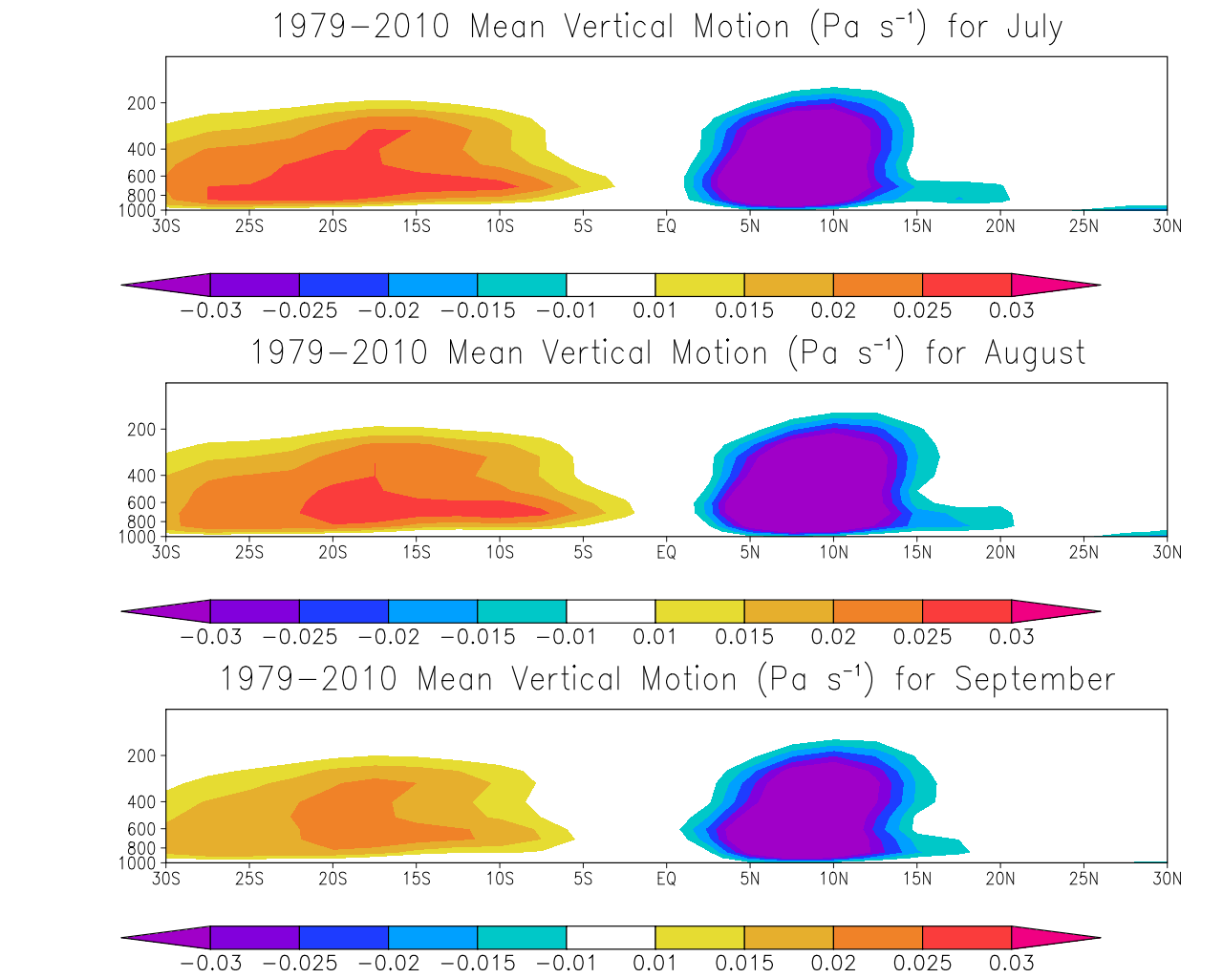
Mean Vertical Motion: Jul-Sep
pressure (hPa)
pressure (hPa)
pressure (hPa)
Figures obtained using the freely available NCEP-DOE Reanalysis II dataset.

Slide 19
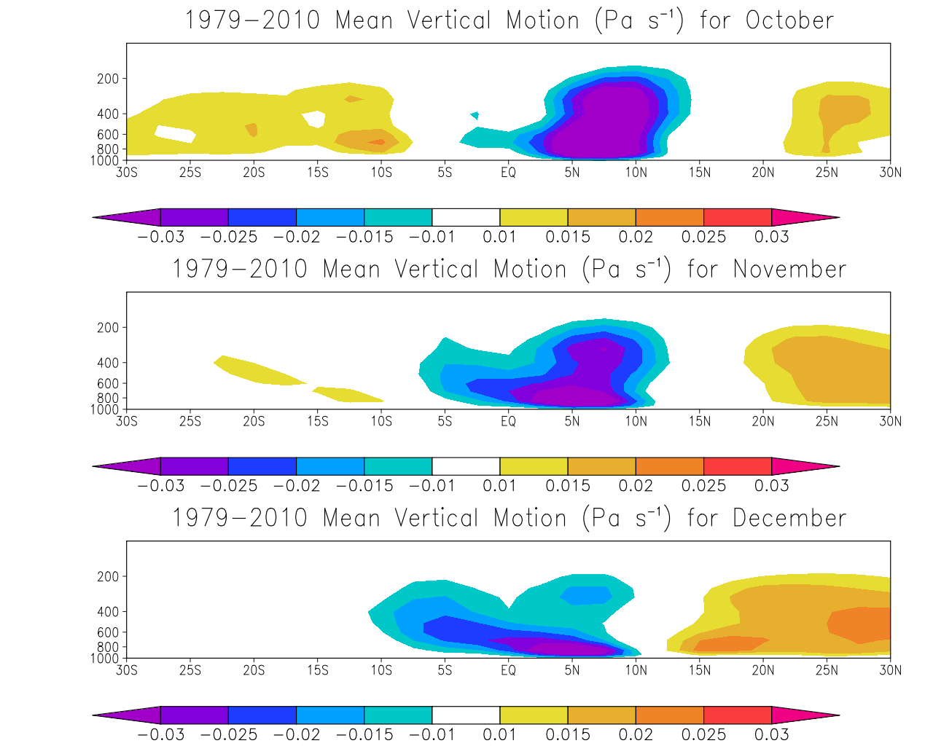
Mean Vertical Motion: Oct-Dec
pressure (hPa)
pressure (hPa)
pressure (hPa)
Figures obtained using the freely available NCEP-DOE Reanalysis II dataset.

Slide 20
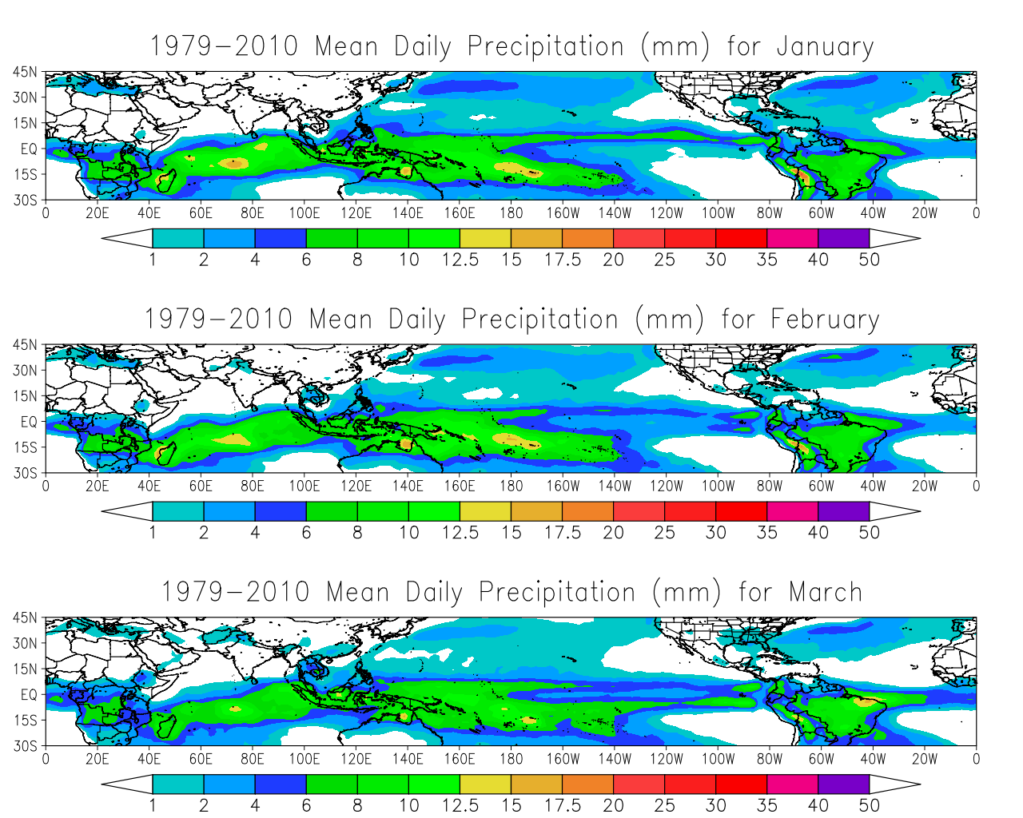
Mean Daily Precipitation: Jan-Mar
Intertropical
Convergence
Zone
Australian
monsoon
S. Atlantic
Convergence
Zone
S. Pacific
Convergence
Zone
Intertropical
Convergence
Zone
Figures obtained using the freely available NCEP-DOE Reanalysis II dataset.

Slide 21
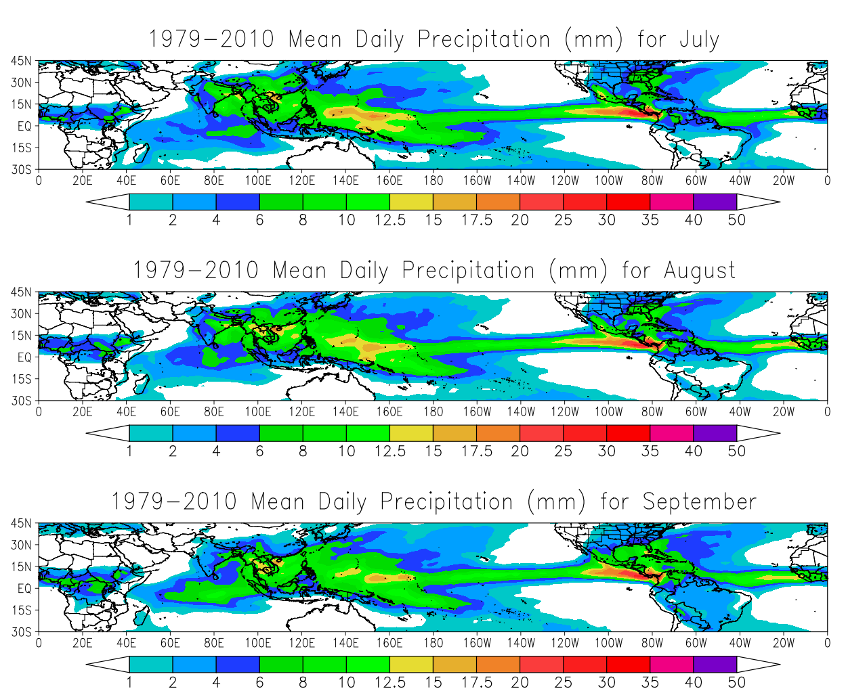
Mean Daily Precipitation: Jul-Sep
Asian monsoon
W. African
monsoon
Poleward shift
of ITCZ in summer
hemisphere
Figures obtained using the freely available NCEP-DOE Reanalysis II dataset.

Slide 22
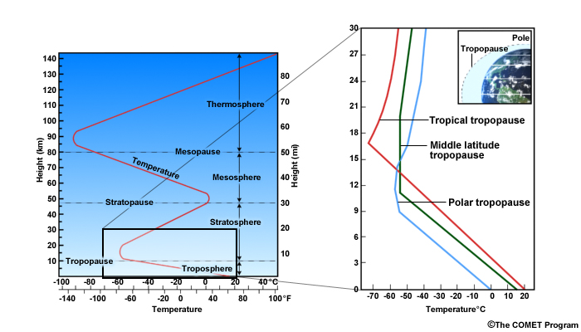
Mean Vertical Structure of the Tropics
(Figure obtained from Introduction to Tropical Meteorology, 2nd Edition, © 2011 COMET.)

Slide 23
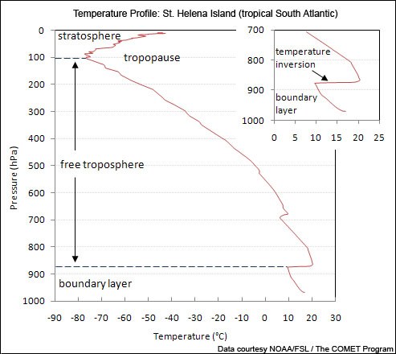
Mean Vertical Structure of the Tropics
(Figure obtained from Introduction to Tropical Meteorology, 2nd Edition, © 2011 COMET.)

Slide 24
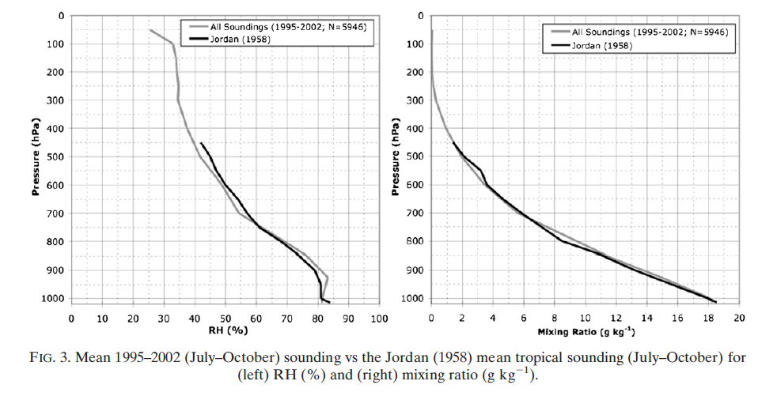
Mean Soundings: Tropical North Atlantic
(Figure obtained from Dunion (2011), their Figure 3. Figure © 2011, American Meteorological Society.)

Slide 25
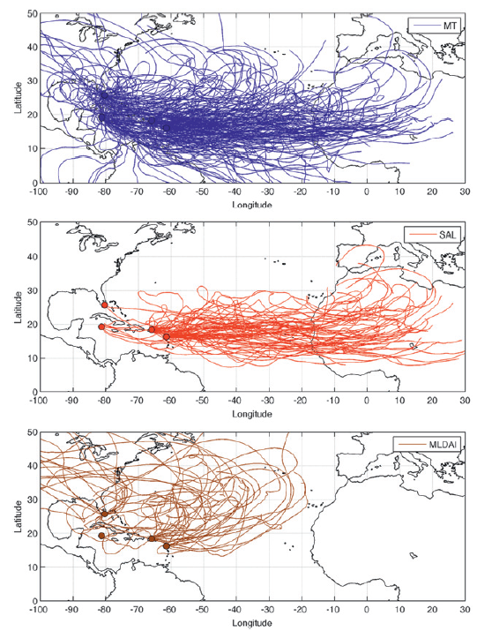
Mean Soundings: Tropical North Atlantic
(Figure obtained from Dunion (2011), their Figure 2. Figure © 2011, American Meteorological Society.)

Slide 26
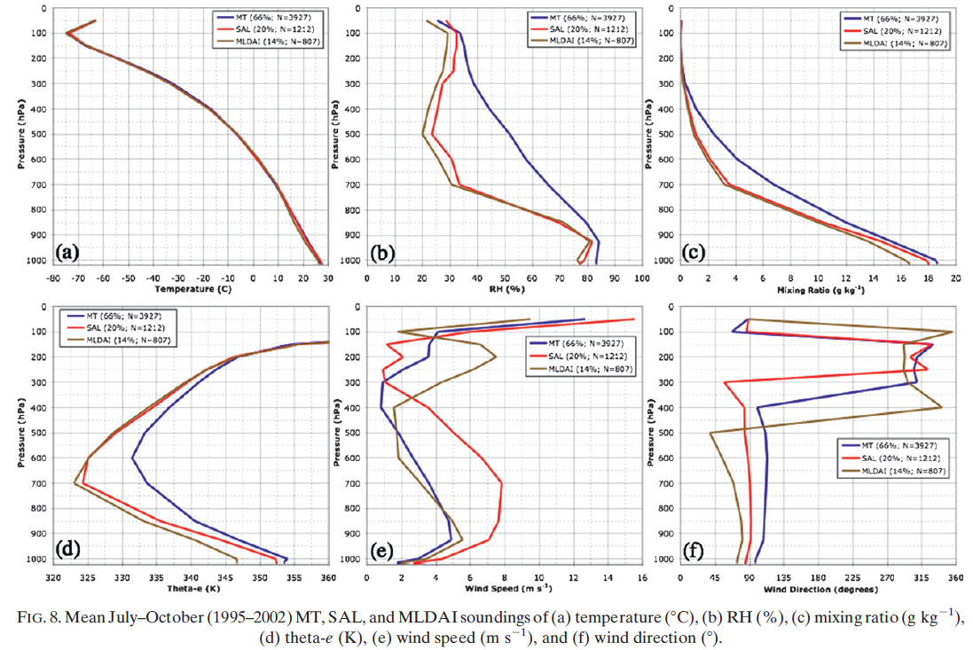
Mean Soundings: Tropical North Atlantic
(Figure obtained from Dunion (2011), their Figure 8. Figure © 2011, American Meteorological Society.)

Slide 27
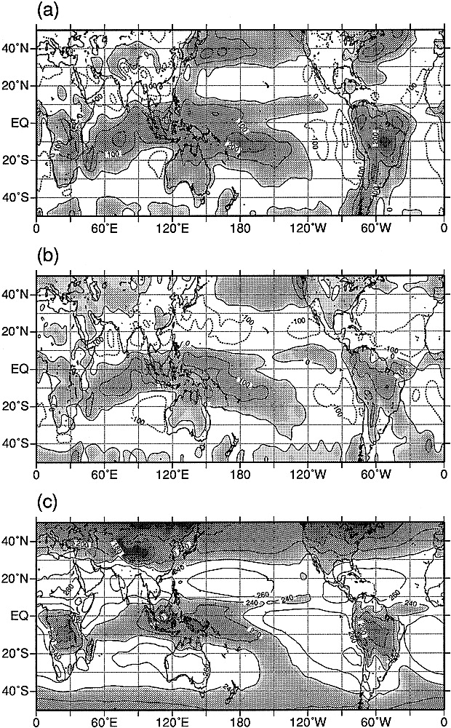
Mean Heat Source, Sink, OLR: Jan-Mar
Heat Source <Q₁>
Moisture Sink <Q₂>
OLR Flux (W m⁻²)
Figure obtained from Yanai and Tomita (1998), their Fig. 1. © 1998, American Meteorological Society.

Slide 28
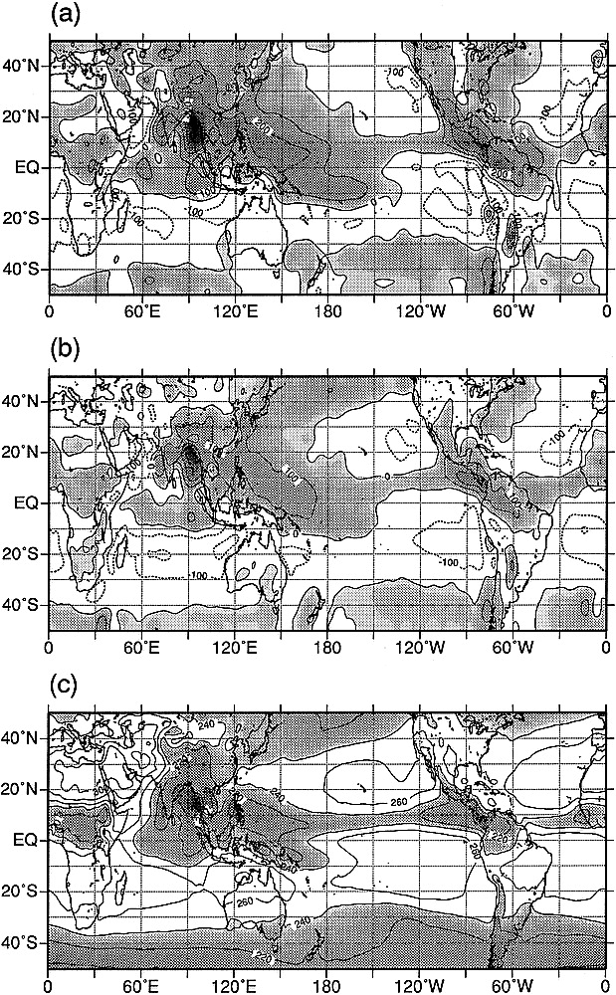
Mean Heat Source, Sink, OLR: Jul-Sep
Heat Source <Q₁>
Moisture Sink <Q₂>
OLR Flux (W m⁻²)
Figure obtained from Yanai and Tomita (1998), their Fig. 3. © 1998, American Meteorological Society.

Slide 29
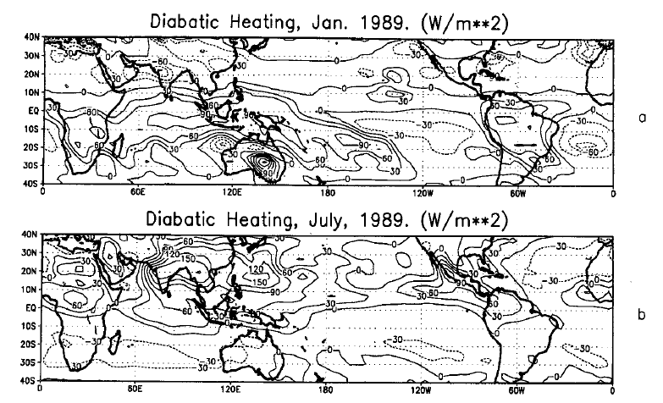
Net Diabatic Heating
Figure obtained from Zhang and Krishnamurti (1996), their Fig. 1. © 1996, American Meteorological Society.

Slide 30
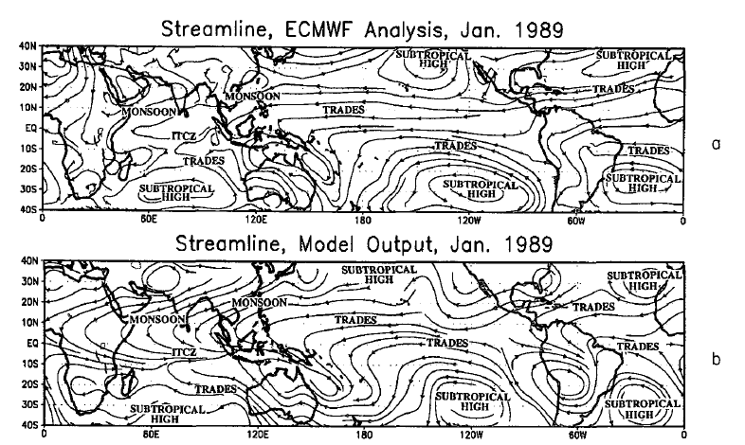
Observations vs. Model: Mean ~850 hPa Flow
Figure obtained from Zhang and Krishnamurti (1996), their Fig. 5. © 1996, American Meteorological Society.

Slide 31
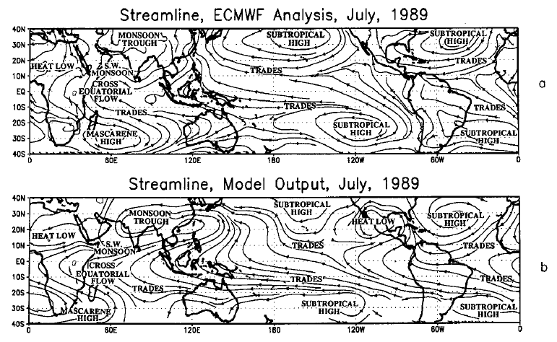
Observations vs. Model: Mean ~850 hPa Flow
Figure obtained from Zhang and Krishnamurti (1996), their Fig. 4. © 1996, American Meteorological Society.

Slide 32
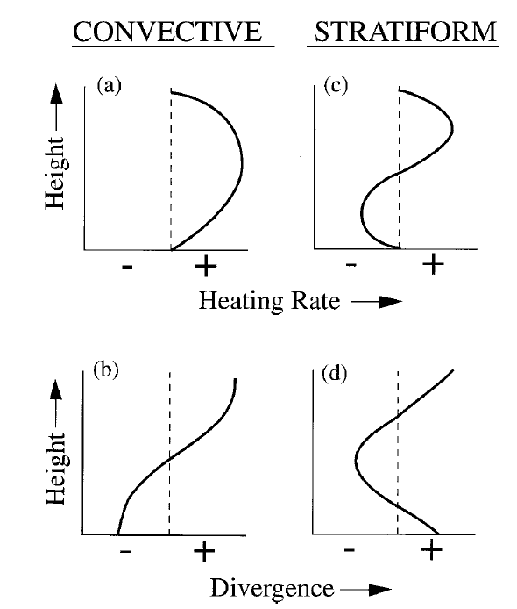
Convective and Stratiform Heating
Figure obtained from Houze (1997), their Fig. 3. © 1997, American Meteorological Society.

